Slide 1
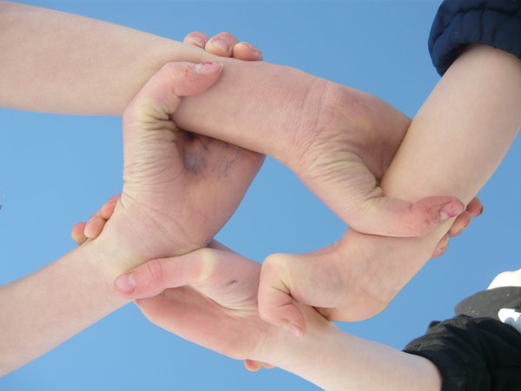
VOLUNTEER SUPPORT
Link to Learning

Slide 2
What does a Volunteer look like?

Slide 3
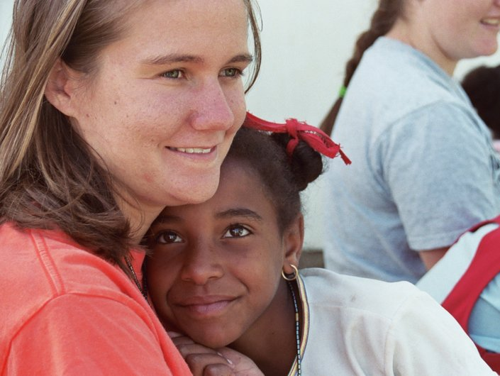
advocate

Slide 4
listener

Slide 5
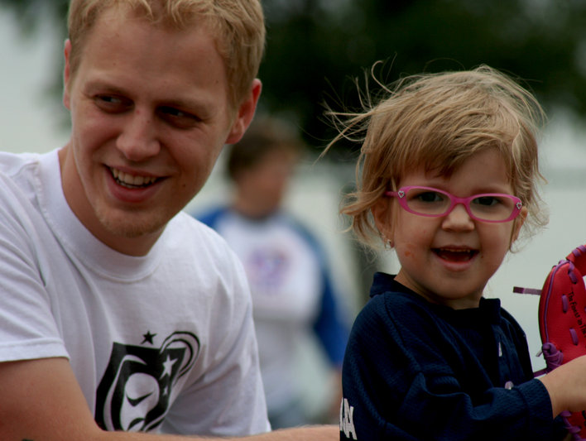
buddy

Slide 6
ambassador

Slide 7
expert

Slide 8
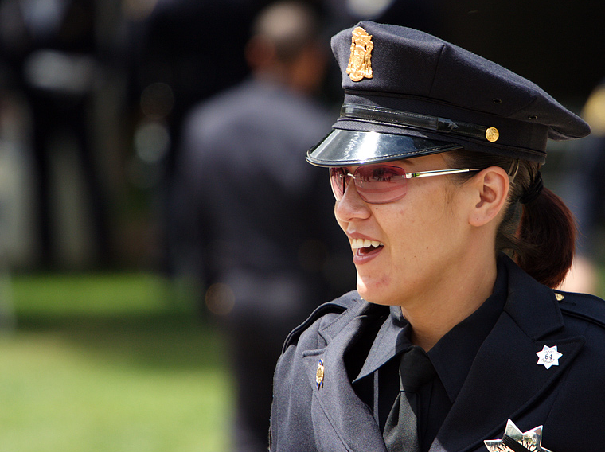
role model

Slide 9
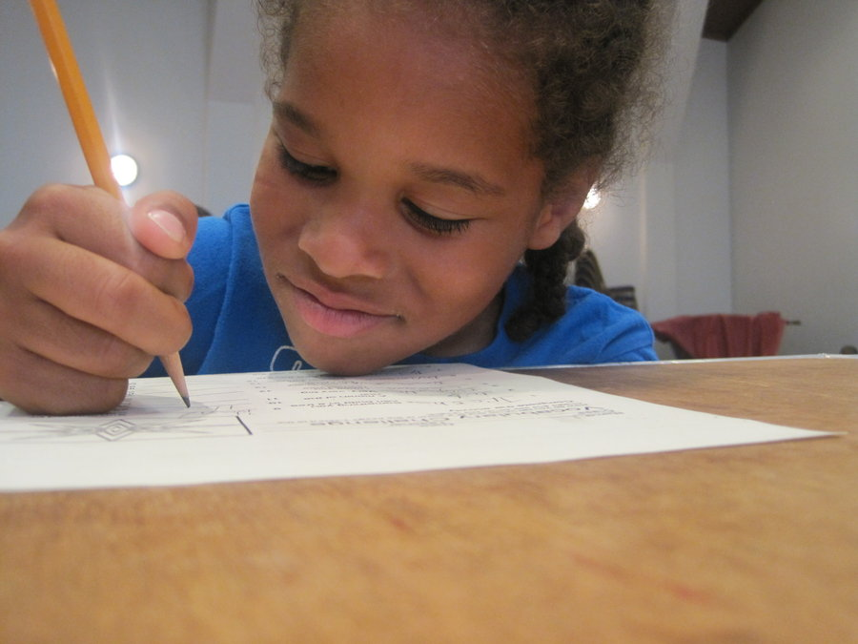
Volunteers
can directly impact…
student achievement

Slide 10
Volunteers can be linked to learning
tutors

Slide 11
Volunteers can provide motivation
mentors

Slide 12
Volunteers provide instructional support
classroom help

Slide 13
PARENT ORGANIZATIONS CAN
raise money
and…
test scores!

Slide 14
Things to consider…
Volunteer Coordinator

Slide 15
Things to consider…
recruit

Slide 16
Things to consider…
train

Slide 17
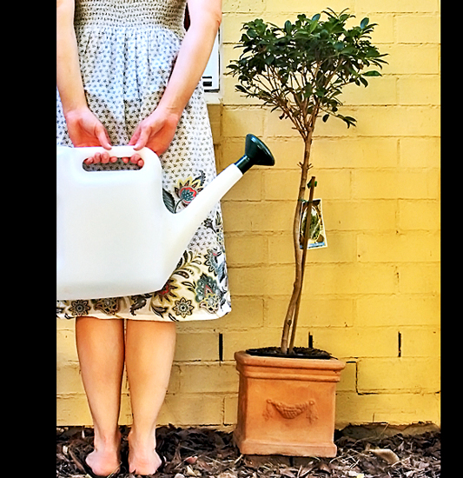
Things to consider…
sustain

Slide 18
Applause! Applause!
appreciate

