Slide 1
Effective Transitions
Engaging Families in the Transition Process
as Children Progress Through Grades & Schools
Notes:
Let’s begin with a question. What is a transition?
For our purposes, transition is a process of successfully moving students from one level to the next.

Slide 2
Transition is a process, not an event.
Dr. Jay Hertzog, Slippery Rock University
Notes:
“Transition is a process, not an event.”
In school there are several recognized transitions:
entering Kindergarten;
going from elementary school to middle school;
moving from middle school to high school;
and graduation to begin one’s postsecondary career.
So why bother focusing on the process of transitions? Why is it so important?

Slide 3
Notes:
Just like a relay runner passing the baton to his teammate, successful transitions must be the responsibility of both the sending school and the receiving school. We, as a school, operate at some point as both.
(Pose this question to the group about the feeder pattern)
Who do we receive our students from? (discuss)
Who are we sending our students to?
Each transition must be executed with planning, collaboration, timing , and practice to ensure students and their families are successful when they move to the next level.

Slide 4
All transitions begin with an ending.
Ending
In-Between State
New Beginning
Notes:
All transitions begin with an ending.
The process can be described as a three-step movement from a stable state (or ending) into an in-between time and then toward a new beginning.

Slide 5
Ending
Notes:
So, why is acknowledging the ending of one phase of their educational journey important?
Because, every ending comes with losses such as
leaving a favorite teacher or principal,
going to a new building or classroom,
changing friendships,
becoming the little fish in a big pond,
…just taking that next step.
We’ve all seen or had students that come to school for the first time and you just know they want to go back to where they came from. Then there are the students that start to get restless during their last year in the building because they just don’t know what is out there.
To be successful receivers or senders of our students, we have to honor what the student and families are leaving and the emotions that come with the move, while celebrating their move towards the new beginning—whatever the next step for them may be.

Slide 6
In-Between State
Notes:
So, why is acknowledging the ending of one phase of their educational journey important?
Because, every ending comes with losses such as
leaving a favorite teacher or principal,
going to a new building or classroom,
changing friendships,
becoming the little fish in a big pond,
…just taking that next step.
We’ve all seen or had students that come to school for the first time and you just know they want to go back to where they came from. Then there are the students that start to get restless during their last year in the building because they just don’t know what is out there.
To be successful receivers or senders of our students, we have to honor what the student and families are leaving and the emotions that come with the move, while celebrating their move towards the new beginning—whatever the next step for them may be.

Slide 7
New Beginning
Notes:
So, why is acknowledging the ending of one phase of their educational journey important?
Because, every ending comes with losses such as
leaving a favorite teacher or principal,
going to a new building or classroom,
changing friendships,
becoming the little fish in a big pond,
…just taking that next step.
We’ve all seen or had students that come to school for the first time and you just know they want to go back to where they came from. Then there are the students that start to get restless during their last year in the building because they just don’t know what is out there.
To be successful receivers or senders of our students, we have to honor what the student and families are leaving and the emotions that come with the move, while celebrating their move towards the new beginning—whatever the next step for them may be.

Slide 8
“It's not so much that we're afraid of change or so in love with the old ways, but it's that place in between that we fear …. It's like being between trapezes. It's Linus when his blanket is in the dryer. There's nothing to hold on to.“
Marilyn Ferguson
Notes:
“It's not so much that we're afraid of change or so in love with the old ways, but it's that place in between that we fear . . . . It's like being between trapezes. It's Linus when his blanket is in the dryer. There's nothing to hold on to.“
This is how many of students and their families feel during that transitional period. They know change is coming but don’t know what to expect.

Slide 9
In-between state
Notes:
So the question is how do we as a school help usher our students and their families through this time.
Here are some things we need to consider:
How do we prepare them?
What information do they need?
What information do we need?
By addressing these questions, we will help our students and their families move into their new beginning with a clearer understanding of where they are and the expectations and possibilities of where they are going.

Slide 10
New Beginning
Notes:
Now the student and their family have arrived at the New Beginning. No matter how well prepared they are for the changes, there is an adjustment time…and that’s okay.
Remember, this process is not just for moving to another school with all new people. It is the same process when students move to a new class or a new floor in the building.
Here are a few questions to consider:
Is there a plan to welcome our student and their family?
Is there a plan to honor our new families?
Is there a plan to connect the new families to the learning process?

Slide 11
Pop Quiz
Which photo best represents transition planning at our school?
Notes:
Now it’s time for a Pop Quiz:
(Pose question) Which photo best represents transition planning at our school?

Slide 12
A
B
C
Notes:
Transition what? Who?—There is no plan in place.
Every man for himself transition planning?—We are planning but it isn’t organized or thought out.
Collaborative, deliberate, intentional transition planning?—Every stakeholder knows the plan is in sync.

Slide 13
Notes:
We need to be deliberate and intentional with our transitions planning. Our planning is most effective when there is a team in place and it’s just not one person planning or several planning their own agenda’s.

Slide 14
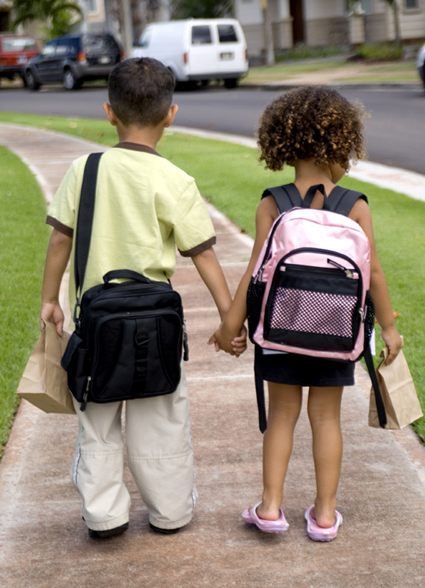
Entering School for the First Time
Kindergarten Transition
Notes:
Before we move on and determine our next steps, here are some examples of transitions events that have worked in our building or at other schools in the district.
The first day of kindergarten brings mixed emotions for parents. Many parents escort their child to their first day of school and into the classroom. But for many it is hard to leave once there, especially if the child is apprehensive.
Some schools have a breakfast at the beginning of the day for kindergarten parents. These breakfasts are a great opportunity to begin building relationships and connect parents to the school. During the breakfast, which is usually donuts, juice and coffee, parents are introduced to the following:
key administrators, such as the principal and other administrators, the parent organization leaders, and available support staff;
Ways to become involved through volunteering;
Other parents.
While this event is usually done at the kindergarten level, the basic concept can be used for those parents with new middle school or high school students.

Slide 15
Moving on to Middle School
Notes:
While all transitions are challenging, the transition to middle school is sometimes considered the most difficult. This is a time of physical, emotional and organizational changes for students. Parents are very apprehensive about this move so we must strive to make them more comfortable so they can support their student. Here are two examples of middle school transition events, one held at a magnet school and at a neighborhood school.
At Hamilton Middle School, Welcome to Royalty was held to welcome future incoming students and their families. The evening provided an opportunity for students and families to meet the staff, take tours, visit with exploratory teachers, ask questions and get more information on attending Hamilton Middle School. There were student tours, information centers, food, music and more. Students and families were able to gain necessary and useful information in a fun and engaging way.
Because Brooks Fine Arts and Technology Middle Magnet is a city wide magnet, it is nearly impossible for the counselor to get to every elementary school to enroll students for fall classes. So after the school receives a list of incoming 6th graders, the school has an enrollment night where students and their parents/guardians come and enroll during the month of May. The school’s counselor, family engagement team, administration, 6th grade team, Exploratory team, Leadership, and parent/volunteer organizations came together and planned a fun and interactive evening that allowed families to experience what was available for them at Brooks, in addition to enrolling for classes.

Slide 16
High School Transition
Preparing for the Future
Notes:
With each transition, the ability to get families involved in the process gets more difficult. But decisions made in high school impact the future of students; what classes they can take, what colleges/trade schools they can attend, etc. Getting families on board from the beginning is key to continued support.
We have two examples of how two high schools have taken steps to connect with students and their families:
To welcome future incoming students and their families, West High School provided students and their families the opportunity to meet the staff and take tours of the school in a fun, relaxing environment—West Fest, an annual family event. Students were identified as VIPs and participated in a scavenger hunt. It was a great way to gain information about the school and experience the culture of West.

Slide 17
Transition is a process, not an event.
Dr. Jay Hertzog, Slippery Rock University
Notes:
It is our responsibility to help our students and their families through the transition process, so how can we best do that so that the process is as smooth as possible? Keeping in mind this quote we read earlier, we’ve listed the things what everyone should know and what we currently to prepare for transitions.

Slide 18
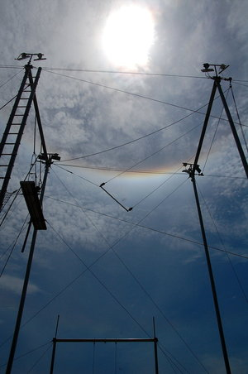
Where do we go from here?
Next Steps
Notes:
We know that we must think of transitions as a process, not an event.
We know that a successful transition plan includes all stakeholders in the student’s success.
We begin by talking about what our students need; what their families need; and what we need to know for a successful transition.
We begin by identifying what we currently do for transitions.
And we begin by compiling a list of possible strategies and activities.
We must move forward. Let’s face it, transition will happen whether we plan or not. So isn’t it smarter to plan?

