Slide 1
Porch Visits
Professional Development and Facilitation
Notes:
A critical piece in improving student achievement is meaningful family engagement.
Research in this area shows a convincing relationship between positive parent involvement and student success.
Building strong family-school partnerships is not accomplished by simply hosting a series of events for families.
True family-school partnerships are built on relationships.

Slide 2
Porch Visits are designed to develop trust and rapport with families by meeting them “on their own turf” where they feel more comfortable and empowered.
Notes:
Effectively engaging parents is a hard job. You don’t just go from point A to point Z.
One of the first steps in engaging families is to take a look ourselves.
Do we welcome them into the school or do we wonder why they are here?
Do we honor their contributions, no matter how small or feel they have nothing to offer?
Do we connect with them and partner with them in the educational success of their child?
It’s really time we take the first step and meet our families where they are - on their turf where they feel more comfortable and empowered. Show them we’ll go out of our way to make them feel welcome.

Slide 3
What do we want to accomplish?
?
Notes:
[Pose Question]
What do we want to accomplish?
(Encourage staff to share ideas.)

Slide 4
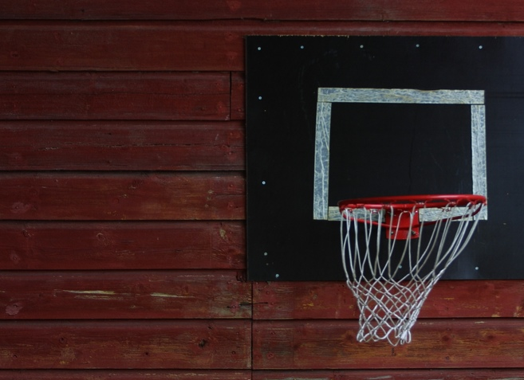
Porch Visit Goals:
Welcome families to the school community.
Establish rapport and put families at ease.
Observe families’ general home environment.
Distribute information.
Promote family engagement and home support.
Notes:
Here are some goals for Porch Visits
Welcome families to the school community.
Establish rapport and put families at ease.
Observe families’ general home environment.
Distribute information.
Promote family engagement and home support.
Porch Visits are NOT the time to:
Discuss behavior or other educational concerns (i.e., dress code, attendance, enrollment forms).

Slide 5
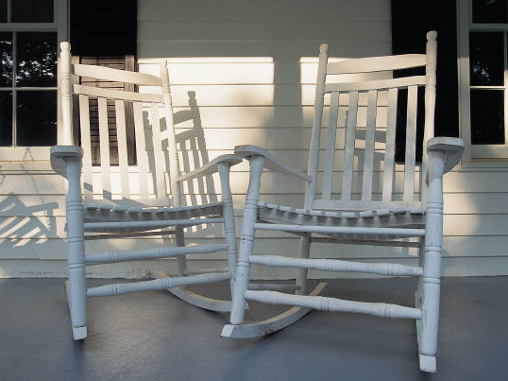
What teachers say …
“We liked bonding as teachers …”
“We enjoyed seeing where our kids live.”
“We were glad to be given the opportunity to meet parents of our students in a positive way.”
Notes:
[Porch Visit quotes from staff]
Read the quotes.

Slide 6
What if my instinct kicks in and I do not feel safe?
Listen to your instinct.
Notes:
Stay alert and trust your instincts. Project a positive attitude and keep an open mind.

Slide 7
Remember
Stay in your teams. No one should go out alone.
No matter what, be positive!
Keep your visit to the porch (outside the home).
If no one is home, leave bags and/or door hangers on handles.
You may not be able to get to every house. Just do your best.
Notes:
[Read the slide]
I’m Begging You:
Stay in your teams. No one should go out alone.
No matter what, be positive!
Keep your visit to the porch (outside the home).
If no one is home, leave bags and door hangers on handles.
You may not be able to get to every house. Just do your best.

Slide 8
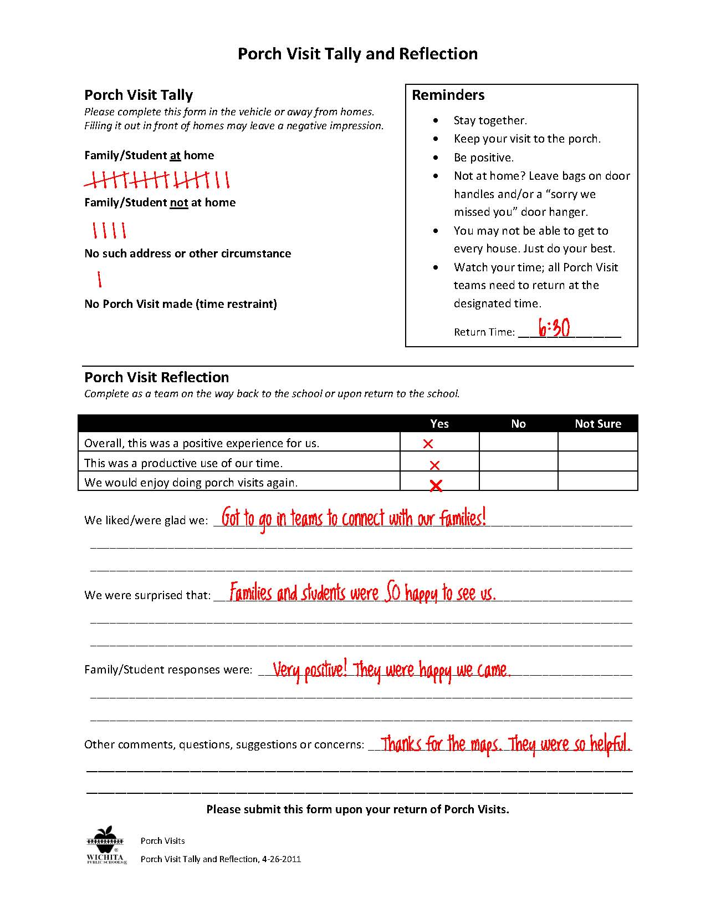
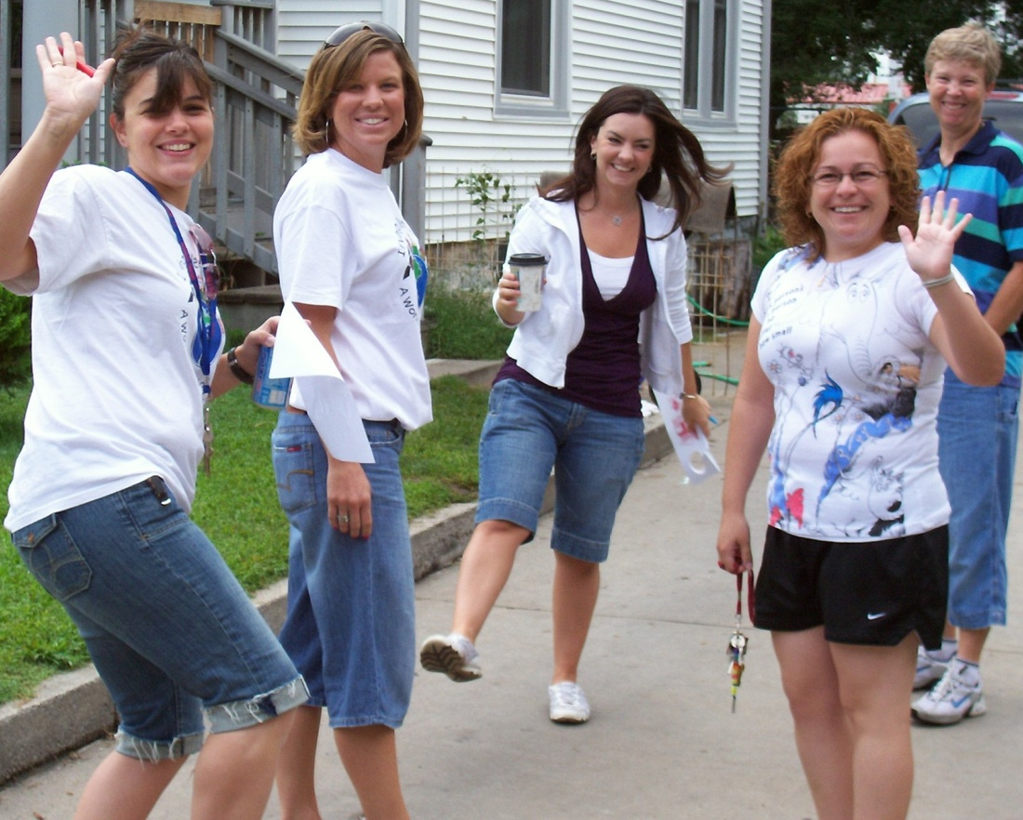
Notes:
While you are conducting visits, please keep a tally of families that were home or not home, or any instances where there was a wrong address, etc.
When completely finished with visits, take a few minutes during the ride back to the school or immediately returning to the school to complete the Reflection portion.
Submit the completed forms upon your return to school [identify a place or person to return the Tally/Reflection]

Slide 9
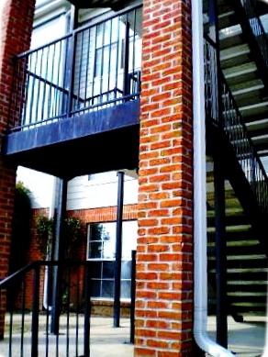
Questions?
Notes:
Any Questions?
[Time to get Porch Visit teams together, distribute materials, Porch Visit team reflections, review other logistics, etc.]

