Slide 1
Moving from
Policy to Practice
in Family Engagement
POLICY
ACTION PLAN
COMPACT

Slide 2
POLICY
ACTION PLAN
COMPACT

Slide 3
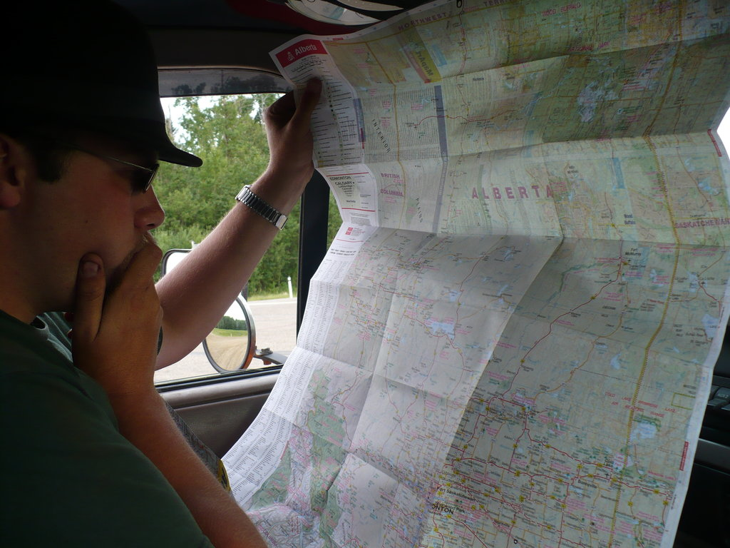
FAMILY
ENGAGEMENT
There is no topic in education on which there is greater agreement than the need for parent involvement.
And yet…
Most schools still need help in developing comprehensive programs of school, family, and community partnerships.
Joyce Epstein
School, Family, and Community Partnerships

Slide 4
FAMILY
ENGAGEMENT
FAMILY
ENGAGEMENT
“Vision without action is merely a dream.
Action without vision just passes the time.
Vision with action can change the world.”
Joel A. Barker

Slide 5
FAMILY
ENGAGEMENT
FAMILY
ENGAGEMENT
Creating a
Parent Involvement POLICY
will provide the clarity of vision needed to move forward.

Slide 6
FAMILY
ENGAGEMENT
FAMILY
ENGAGEMENT
A Parent Involvement
POLICY
Makes a statement about the value of partnerships between home and school.
Expresses a belief that this partnership will positively impact student achievement.
Identifies focus areas for working together.

Slide 7
FAMILY
ENGAGEMENT
FAMILY
ENGAGEMENT
A Parent Involvement POLICY
Makes a statement about the value of partnerships between home and school.
Expresses a belief that this partnership will positively impact student achievement.
Identifies focus areas for working together.

Slide 8
FAMILY
ENGAGEMENT
FAMILY
ENGAGEMENT
A Parent Involvement POLICY
Makes a statement about the value of partnerships between home and school.
Expresses a belief that this partnership will positively impact student achievement.
Identifies focus areas for working together.

Slide 9
FAMILY
ENGAGEMENT
FAMILY
ENGAGEMENT
NOW WHAT?
How will we reach our destination?
What are the most direct routes to follow?
How can we avoid road blocks?
How will we know we have arrived?
WE NEED A PLAN!

Slide 10
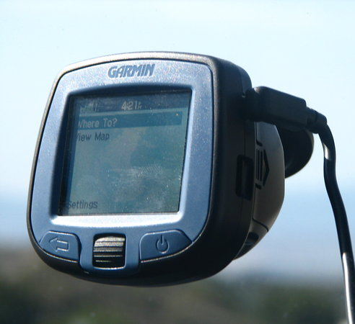
FAMILY
ENGAGEMENT
FAMILY
ENGAGEMENT
A Family Engagement ACTION PLAN
Provides clear and concise directions for reaching our destination.
Maps out the expected timeline
Provides methods for measuring distance traveled
Identifies landmarks along the way.

Slide 11
FAMILY
ENGAGEMENT
FAMILY
ENGAGEMENT
A Family Engagement ACTION PLAN
Provides clear and concise directions for reaching our destination.
Maps out the expected timeline
Provides methods for measuring distance traveled
Identifies landmarks along the way.

Slide 12
FAMILY
ENGAGEMENT
FAMILY
ENGAGEMENT
A Family Engagement ACTION PLAN
Provides clear and concise directions for reaching our destination.
Maps out the expected timeline
Provides methods for measuring distance traveled
Identifies landmarks along the way.

Slide 13
FAMILY
ENGAGEMENT
FAMILY
ENGAGEMENT
A Family Engagement ACTION PLAN
Provides clear and concise directions for reaching our destination.
Maps out the expected timeline
Provides methods for measuring distance traveled
Identifies landmarks along the way.

Slide 14
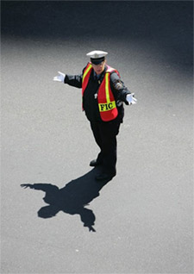
FAMILY
ENGAGEMENT
FAMILY
ENGAGEMENT
Almost there…
How will we COMMUNICATE our plans with all stakeholders?

Slide 15
FAMILY
ENGAGEMENT
FAMILY
ENGAGEMENT
COMMUNICATION
A perfect plan is only perfect when
EVERYONE
understands their roles and responsibilities.
It’s time to share the
rules of the road.

Slide 16
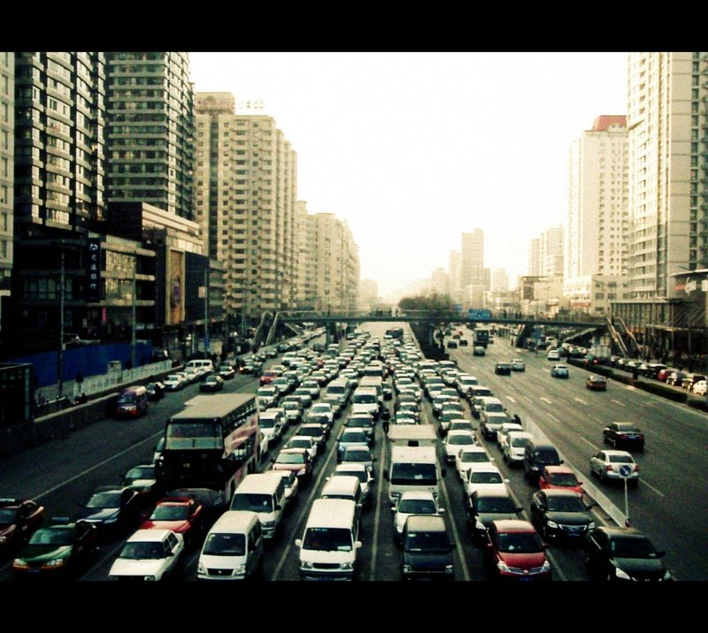
FAMILY
ENGAGEMENT
FAMILY
ENGAGEMENT
Parent Involvement
COMPACT
Helps align everyone and assure we are headed in the same direction.
Provides clear expectations and goals.
Outlines the distinct responsibilities of each person.

Slide 17
FAMILY
ENGAGEMENT
FAMILY
ENGAGEMENT
Parent Involvement
COMPACT
Helps align everyone and assure we are headed in the same direction.
Provides clear expectations and goals.
Outlines the distinct responsibilities of each person.

Slide 18
FAMILY
ENGAGEMENT
FAMILY
ENGAGEMENT
Parent Involvement
COMPACT
Helps align everyone and assure we are headed in the same direction.
Provides clear expectations and goals.
Outlines the distinct responsibilities of each person.

Slide 19
FAMILY
ENGAGEMENT
FAMILY
ENGAGEMENT
When all three
documents are
ALIGNED
POLICY
ACTION PLAN
COMPACT

Slide 20
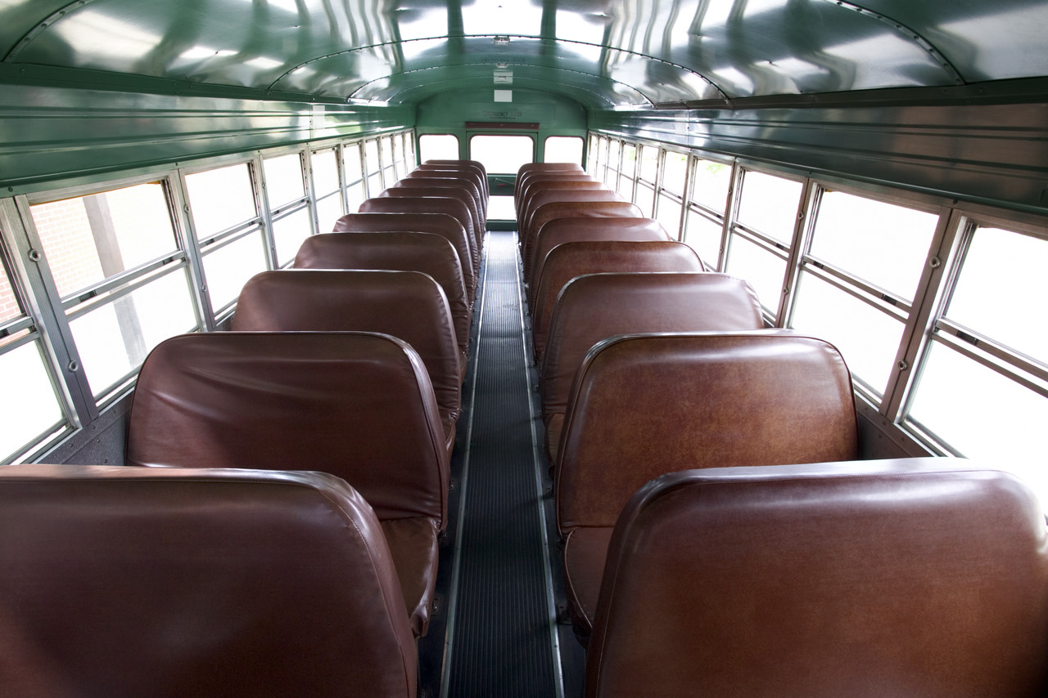
FAMILY
ENGAGEMENT
FAMILY
ENGAGEMENT
When all three
documents are
ALIGNED
Not only will we be
heading the same DIRECTION

Slide 21
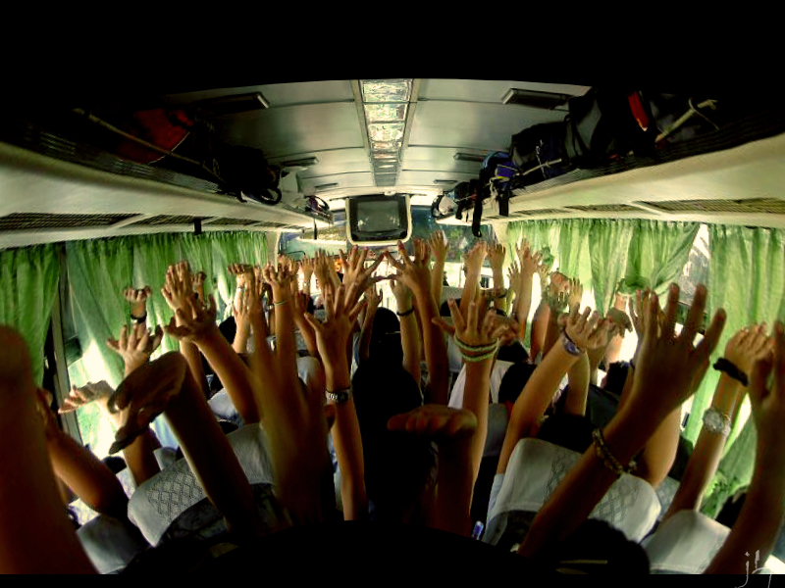
FAMILY
ENGAGEMENT
FAMILY
ENGAGEMENT
When all three
documents are
ALIGNED
Not only will we be
heading the same DIRECTION
We will all arrive
TOGETHER
In the same vehicle.

