Slide 1
Effective School – Business - Community Partners
Notes:
This slide is to be shown while audience is gathering and getting seated. (Title page)

Slide 2
There are over SIX BILLION
people on earth today
Notes:
They say that schools are a reflection of our society at large.
Remember when we first started hearing the term “global learners?” Looking back, our understanding of what “global” meant, was very narrow. Not really global at all! Consider all the avenues we have now to instantly be in communication with someone on the other side of the world. One would think that we feel very connected right now.

Slide 3
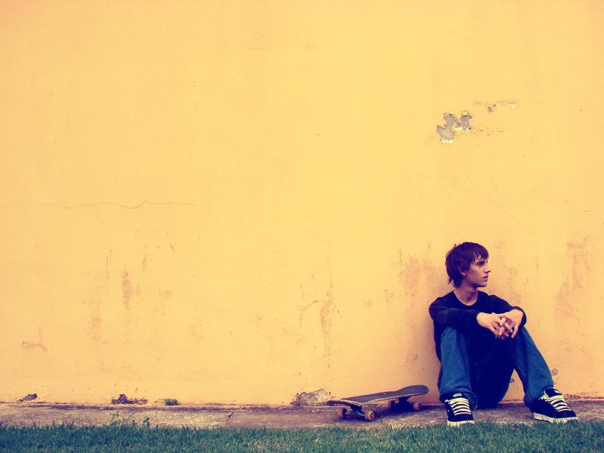
So why do we often feel so ISOLATED
Notes:
But, are we coming together or coming apart?
It may seem like a contradiction, but in the midst of all this connectedness, researchers say we are actually feeling more alone.
Instead of playing on a baseball team, we are now playing baseball on our wii’s. In our living room. Alone.

Slide 4
A child does not go to school ALONE
Notes:
Although students may enter our schools and classrooms as individuals, we know there is more than what meets the eye.

Slide 5
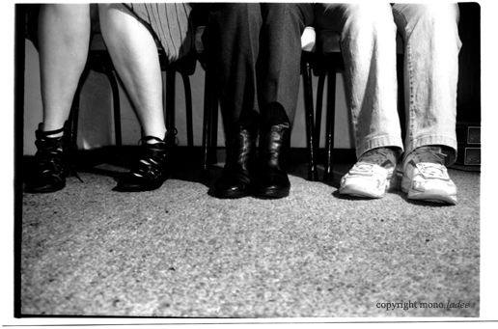
Each child brings with them…
a FAMILY
Notes:
Along with a backpack, a child carries the hopes and dreams of an entire family on their back. They also bring their own unique background, culture, experiences, and expectations.

Slide 6
No TEACHER
goes to school alone…
Notes:
Teachers enter the classroom with years of college, research, curriculum, and knowledge about their jobs. And they spend their days surrounded by noise, students, and colleagues. They meet together, learn together, and plan together.

Slide 7
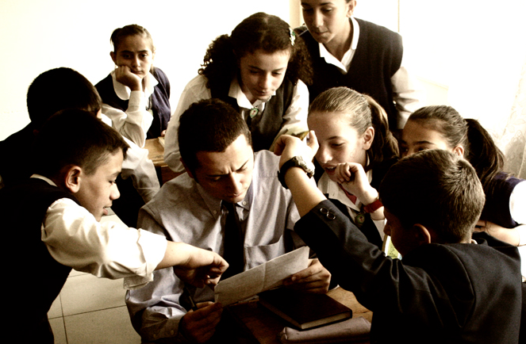
But it can sometimes FEEL that way.
Notes:
But at the end of the day, teachers can very easily feel alone and isolated. They have briefcases instead of backpacks, and they are stuffed full of papers to grade, lessons to plan, reports to complete, and their own expectations.

Slide 8
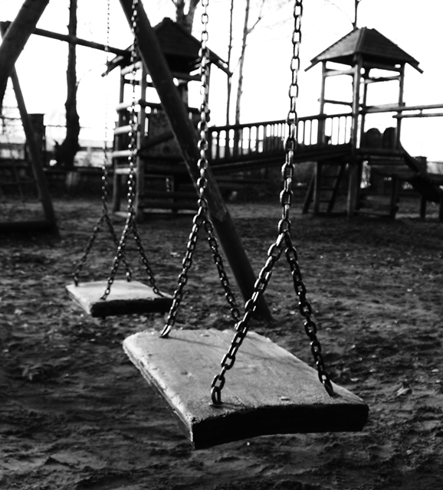
No school
is an ISLAND
Notes:
Schools may sit on busy streets or tucked into quiet neighborhoods. They are part of a larger community. Yet, they may not be truly connected to that community in a meaningful way. When it comes to going about the business of educating students, schools often function as separate and isolated entities.

Slide 9
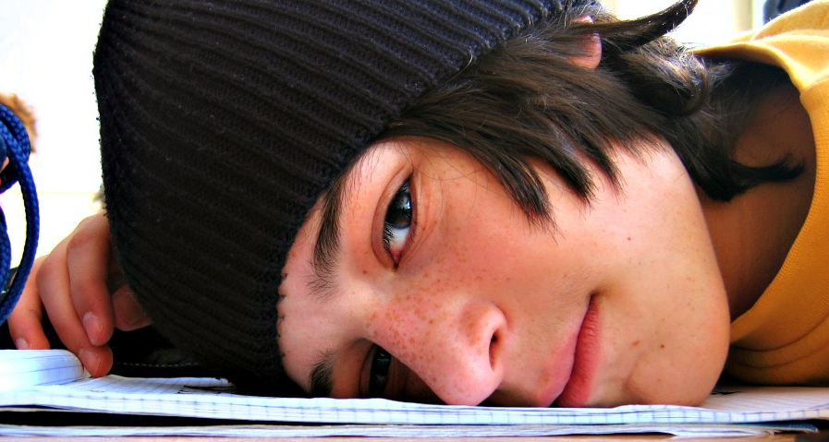
It’s all about
RELATIONSHIPS
Notes:
It’s no surprise that we hear the phrase, “It’s all about relationships”, everywhere we go. We hear this discussion at the board table and the breakfast table.
When we discuss assessment scores, we invariably agree that we must form relationships with students if we are to reach them, and teach them.
In order to succeed, we must reach out and connect with those around us. We simply cannot succeed by ourselves.

Slide 10
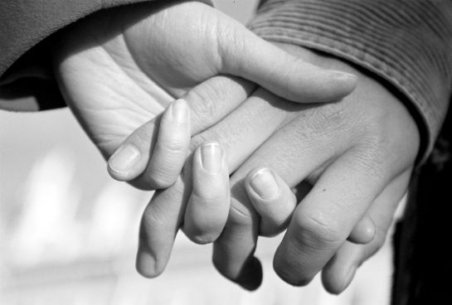
You need a PARTNER
Notes:
We have come to realize that we need help. We need a partner. We need someone to join us on our journey and support us in our work and our lives.

Slide 11
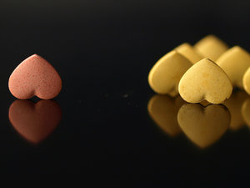
It’s time to
REACH OUT
Match.com
eHarmony.com
Chemistry.com
Notes:
But how do we find a suitable match to join us in our work? Hmmmm… what does this remind us of? Again, we are a reflection of the society at large. And the society at large has discovered that we may indeed be surrounded by six billion people, but we need help in finding the right partner…. Sound familiar?

Slide 12
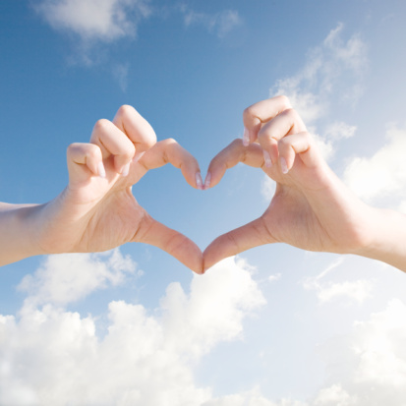
partners
.c m
Where school &community
go hand –in- hand.
Create Profile
Define Needs
Begin Search
Compatibility
collaborative
ongoing
mutually beneficial
Commitment
Stay Together
Notes:
Let’s look at what makes online dating sites so successful? How can looking for a partner be made into a formula that can search for and find compatible candidates?
And how would we define a partner that is right for us? What exactly are we looking for? Let’s start with the basics…
(point out that .COM stands for collaborative, ongoing, and mutually beneficial)

Slide 13
partners
.c m
Create Profile
[COLLABORATIVE]
Define Needs
We’re in this together
We share the same goals
We understand our roles
We are stronger as a team
Begin Search
Compatibility
Commitment
Stay Together
Notes:
Before we even begin to search for a partner, we need to understand that we are creating a team. We will work together as a team.

Slide 14
partners
.c m
Create Profile
Define Needs
ON-GOING
Begin Search
More than just a “fling”
Long term commitment
Growing together
Compatibility
Commitment
Stay Together
Notes:
As partners, we must work to maintain our relationship. As partners, we must think long term in order to be truly successful and effective.

Slide 15
partners
.c m
MUTUALLY
BENEFICIAL
Create Profile
Define Needs
Give and take
Meet the needs of both partners
Begin Search
Compatibility
Commitment
Stay Together
Notes:
This is the tough one. It is easy to identify ways that a school can benefit from having an outside partner. But the word PARTNER implies that this must be more than “What have you done for me lately?” A partner relationship needs be MUTUALLY beneficial. Simply receiving donations from a business or agency, is not mutually beneficial. That does not mean that we should abandon those wonderful benefactors who support our schools with donations of time, money, and things like books, coats, or tutors. Instead, we should examine those relationships and seek ways to take them to the next level.

Slide 16
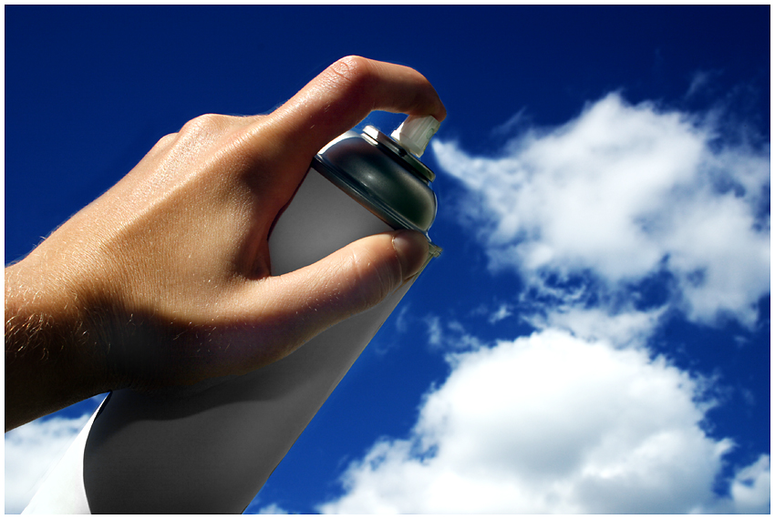
partners
.c m
Let’s START
Create Profile
Define Needs
Begin Search
Create your profile
Determine your needs
Begin your search
Chemistry & Compatibility
Making a commitment
Compatibility
Commitment
Stay Together
Notes:
Online dating sites have already figured out how to organize your search for a partner. There is no reason to reinvent the wheel. Let’s look at the ways they help millions of people find a perfect match.

Slide 17
partners
.c m
Create Your PROFILE
Who are you?
Stand out in a crowd.
What makes you unique?
How do you communicate?
Create Profile
Define Needs
Begin Search
Compatibility
Commitment
Stay Together
Notes:
Step number one in most sites is to clearly define who YOU are. This is your marketing piece. You cannot begin to search for a partner until you can clearly communicate who you are. In other words, create your profile.

Slide 18
partners
.c m
Define Your NEEDS
Make a wish.
Be specific.
What do you need?
Create Profile
Define Needs
Begin Search
Compatibility
Commitment
Stay Together
Notes:
What are you looking for? Have you taken the time to sit down and list your goals and expectations? Begin by asking, “WHY am I looking for a partner in the first place? What do I have to gain? What can I give in return?

Slide 19
partners
.c m
Create Profile
Begin Your Search
Look for similar interests.
Share your goals and
PRIORITIES.
Know your
Boundaries.
Define Needs
Begin Search
Compatibility
Commitment
Stay Together
Notes:
Now that you have defined who you are and who you are looking for… the site will allow you to start searching!
Yikes! This is exciting, BUT… it can be a daunting task.

Slide 20
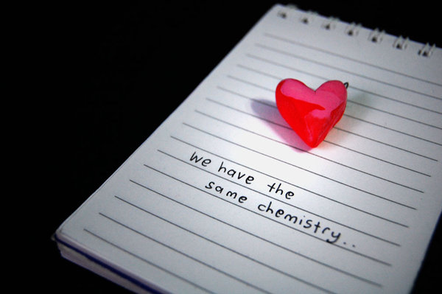
partners
.c m
Create Profile
COMPATIBILITY
Is this a
good
fit?
Define Needs
Begin Search
Compatibility
Commitment
Stay Together
Notes:
Obviously, there is more to consider than looks alone.
A partner candidate may appear to be compatible with your needs until you meet and discuss the specifics.
Do you share the same expectations?
Do you both understand what this relationship will require of each of you?
Do you understand and agree on your roles and responsibilities?
Have you discussed the desired outcomes?
If so…. You may be ready for the next step!

Slide 21
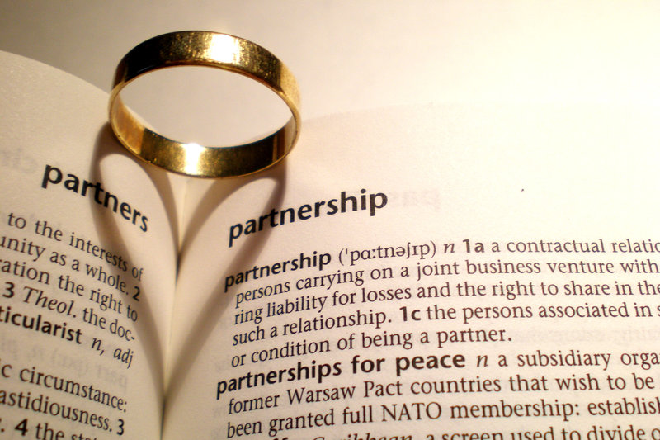
partners
.c m
Create Profile
Making a COMMITMENT
Are you really ready?
Saying “I DO”
Do you need a piece of paper?
Define Needs
Begin Search
Compatibility
Commitment
Stay Together
Notes:
That’s right… it’s time to discuss making a commitment.
Signing a Partner Agreement Form will declare your intentions to create and maintain a lasting relationship, and help to define your arrangements.

Slide 22
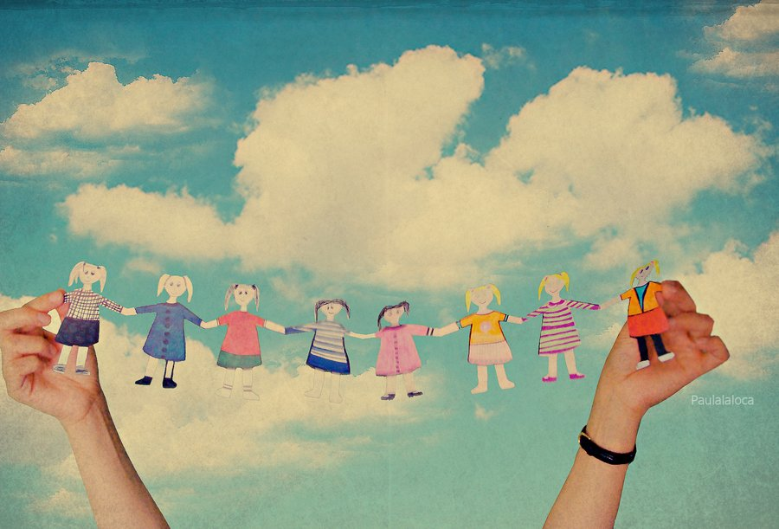
partners
.c m
Staying together
FOR THE KIDS
Evaluating existing partnerships.
Honoring the agreement.
Handling change.
Create Profile
Define Needs
Begin Search
Compatibility
Commitment
Stay Together
Notes:
We’re not done yet….
What happens if someone leaves? Do you have plans in place for keeping your relationship intact and functioning? A good partner team will know how to survive and thrive during times of change.

Slide 23
Simply put…
True partnerships are:
collaborative
on-going
mutually beneficial
and BUILT TO LAST

