Slide 1
Policy = Vision
Action Plan = Actions
Compact = Communication

Slide 2
Action Plan = Actions
Step 1: Review
Resource: Assessing Current Family Engagement Strategies for Impact
Description:
Review your 2010-2011 Family Engagement Action Plan goals and strategies for impact and decide what will be kept for next year.

Slide 3
Action Plan = Actions
Step 2: Consider
Resource: Beginning the Planning Cycle Ideas and Resources
Description:
Brainstorm new goals and strategies for consideration.

Slide 4
Action Plan = Actions
Step 3: Plan and Evaluate
Resource: Roadmap to Action and Guiding Questions for Goals and Initiatives
Description:
Use the Roadmap to Action process for each goal to determine what strategies to use. The Guiding Questions for Goals and Initiatives will help set family-focused goals.

Slide 5
Action Plan = Actions
Step 4: Final Format
Resource: 2011-2012 Family Engagement Action Plan (Aug. – Oct. only)
Description:
Transfer information from the Roadmap to Action to your 2011-2012 Family Engagement Action Plan. Rough draft/handwritten acceptable.

Slide 6
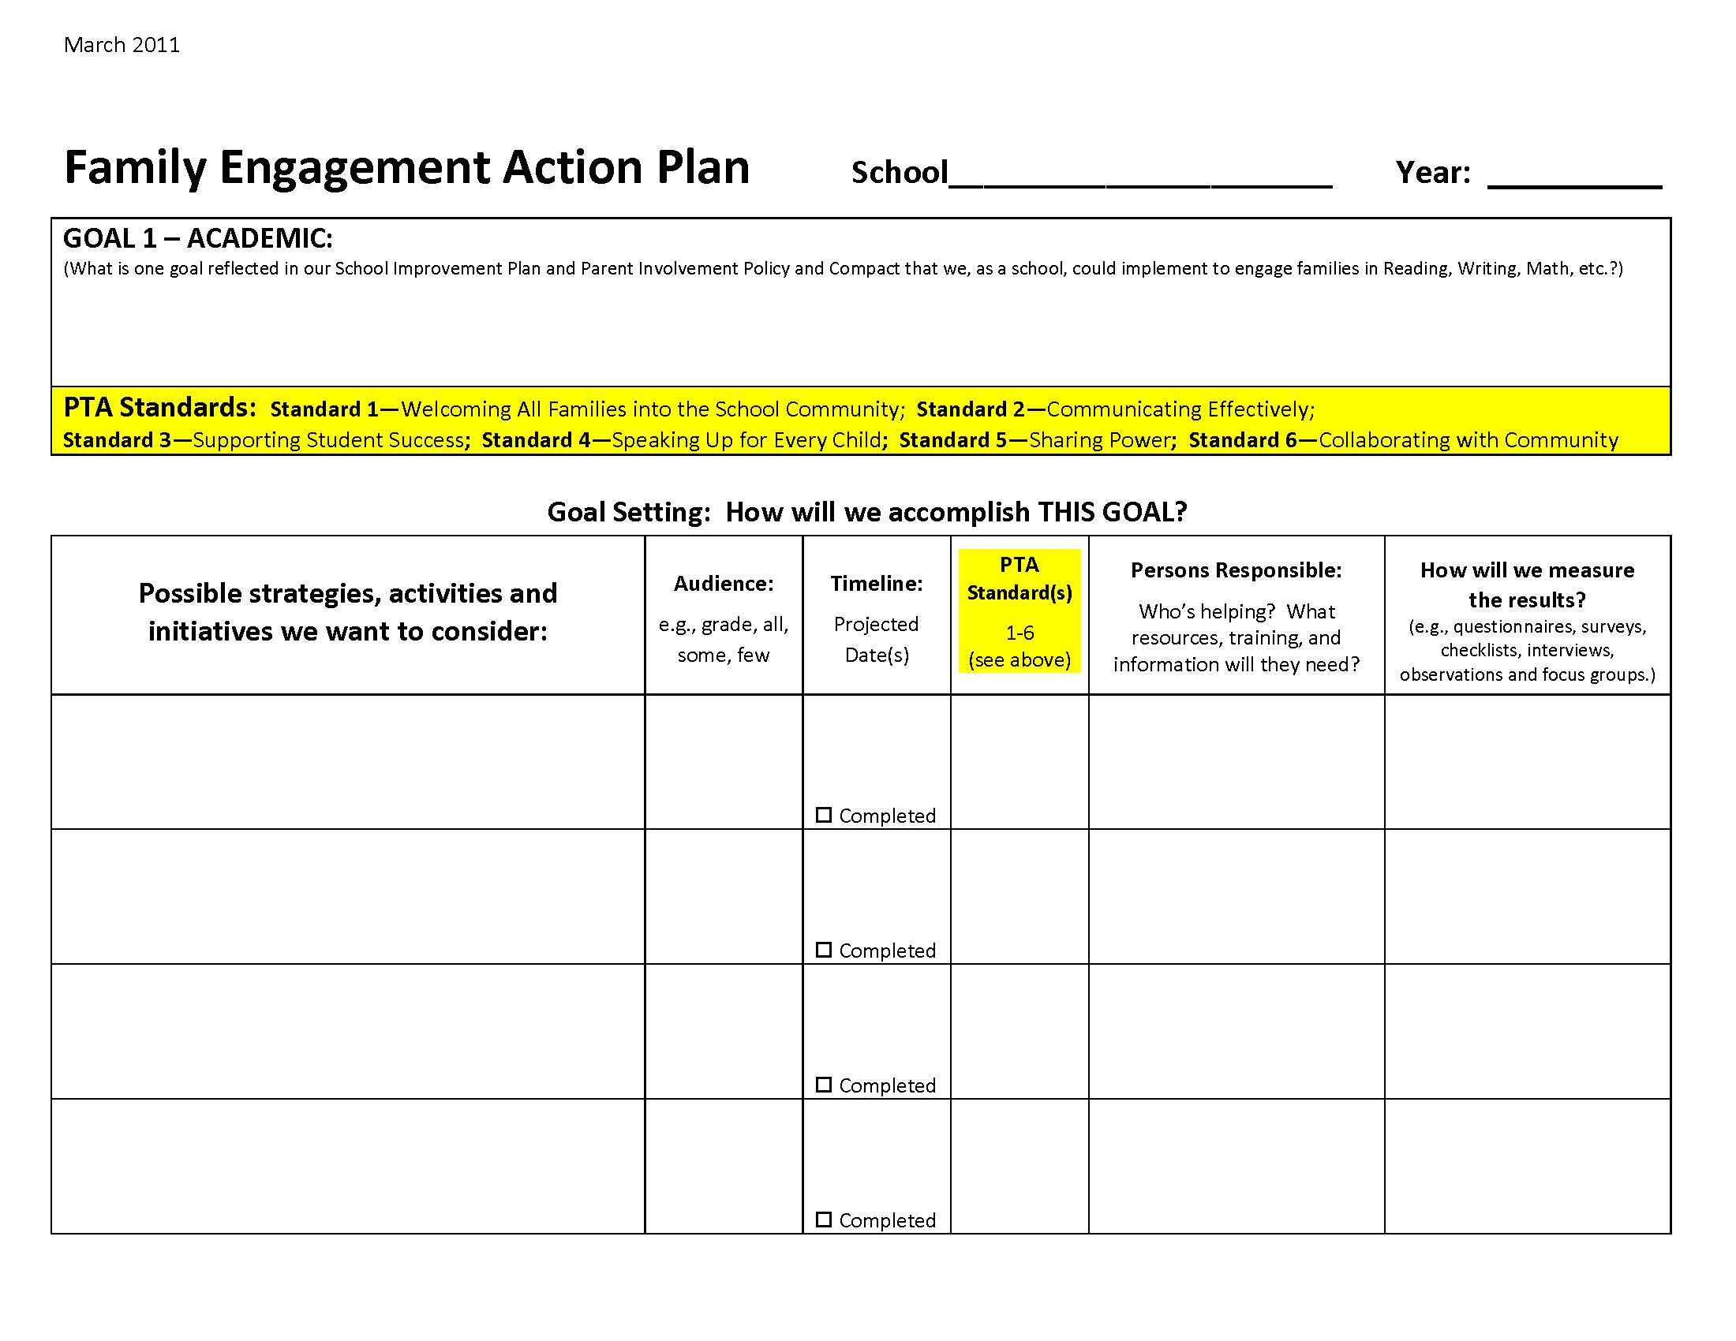

Slide 7
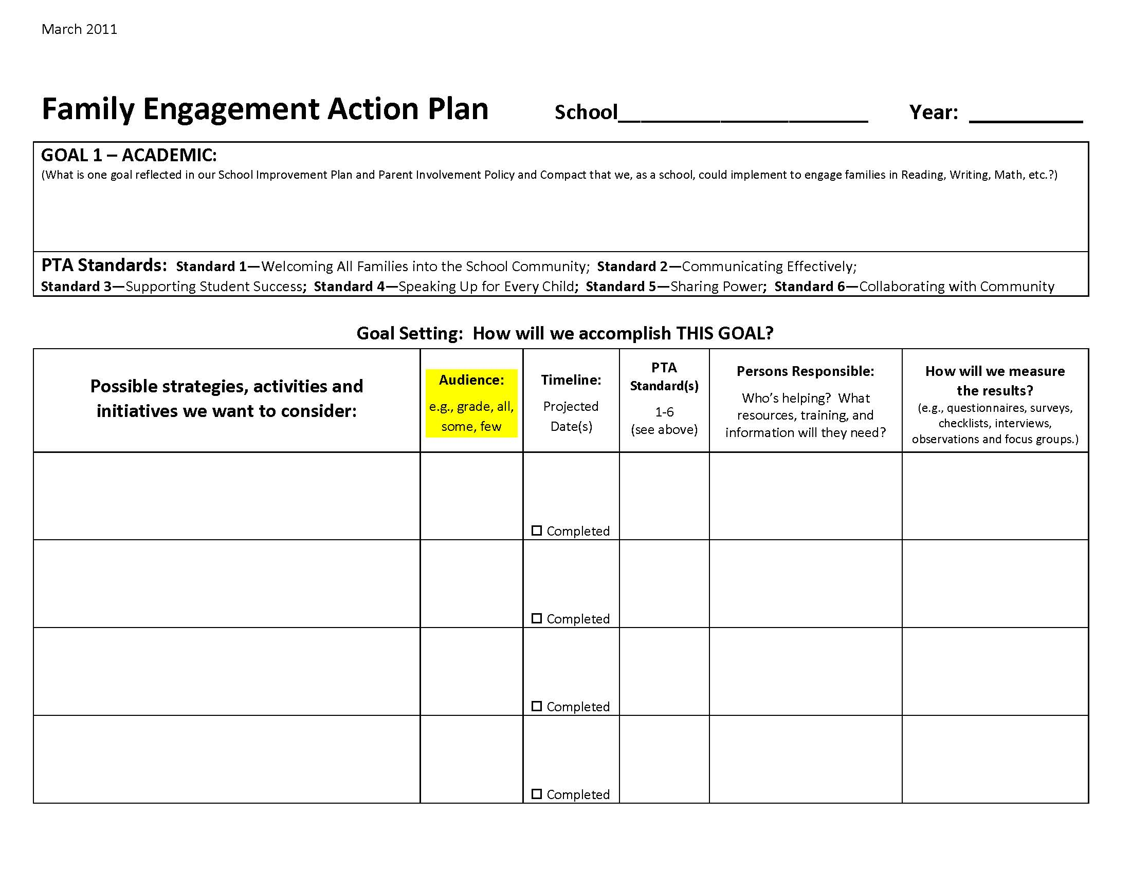

Slide 8
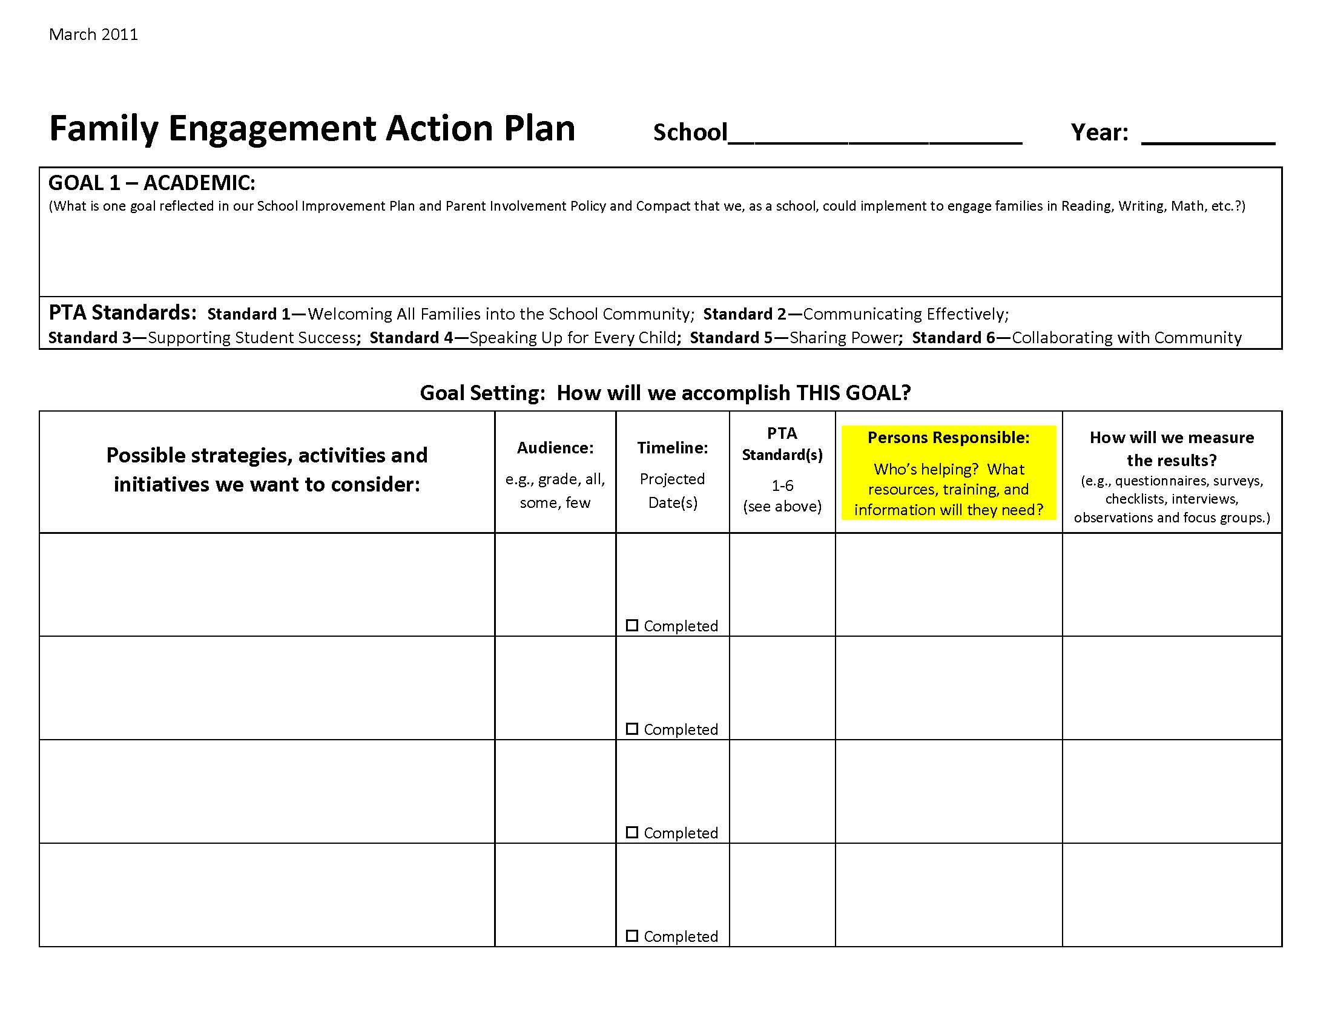

Slide 9
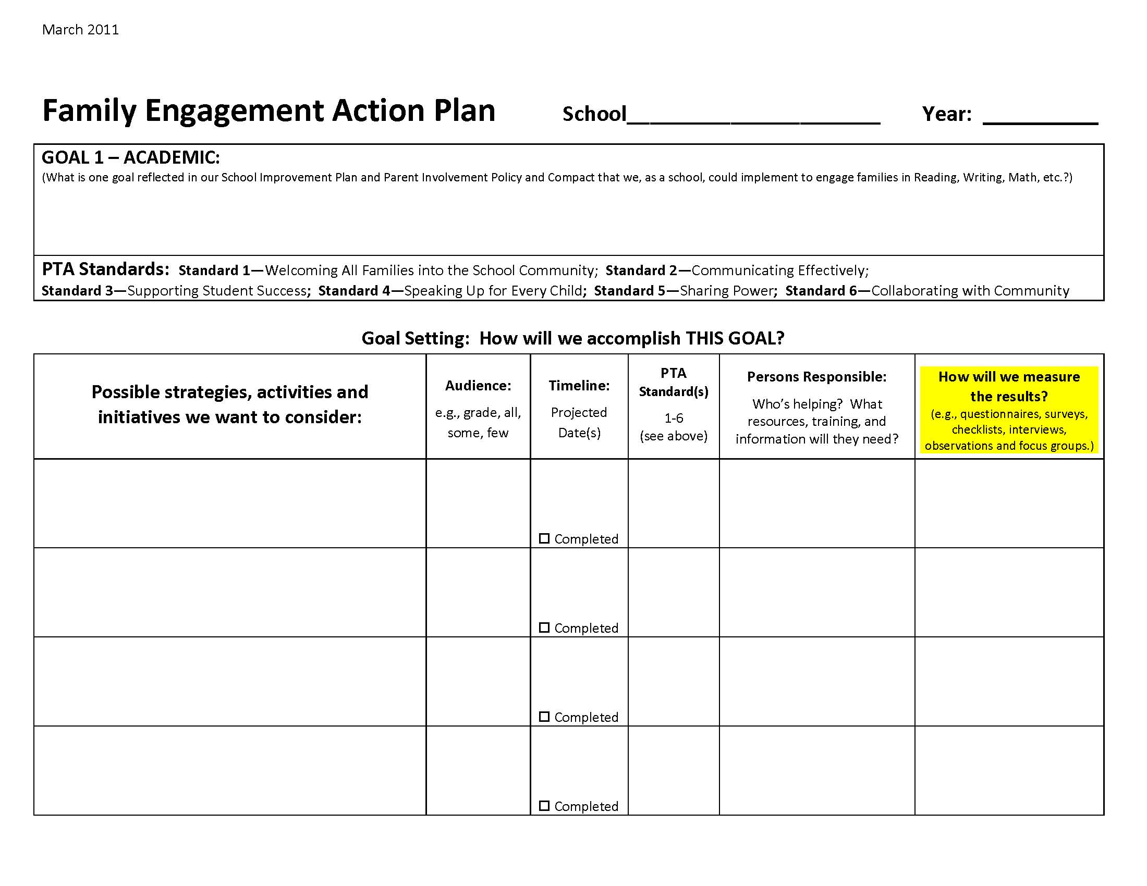

Slide 10
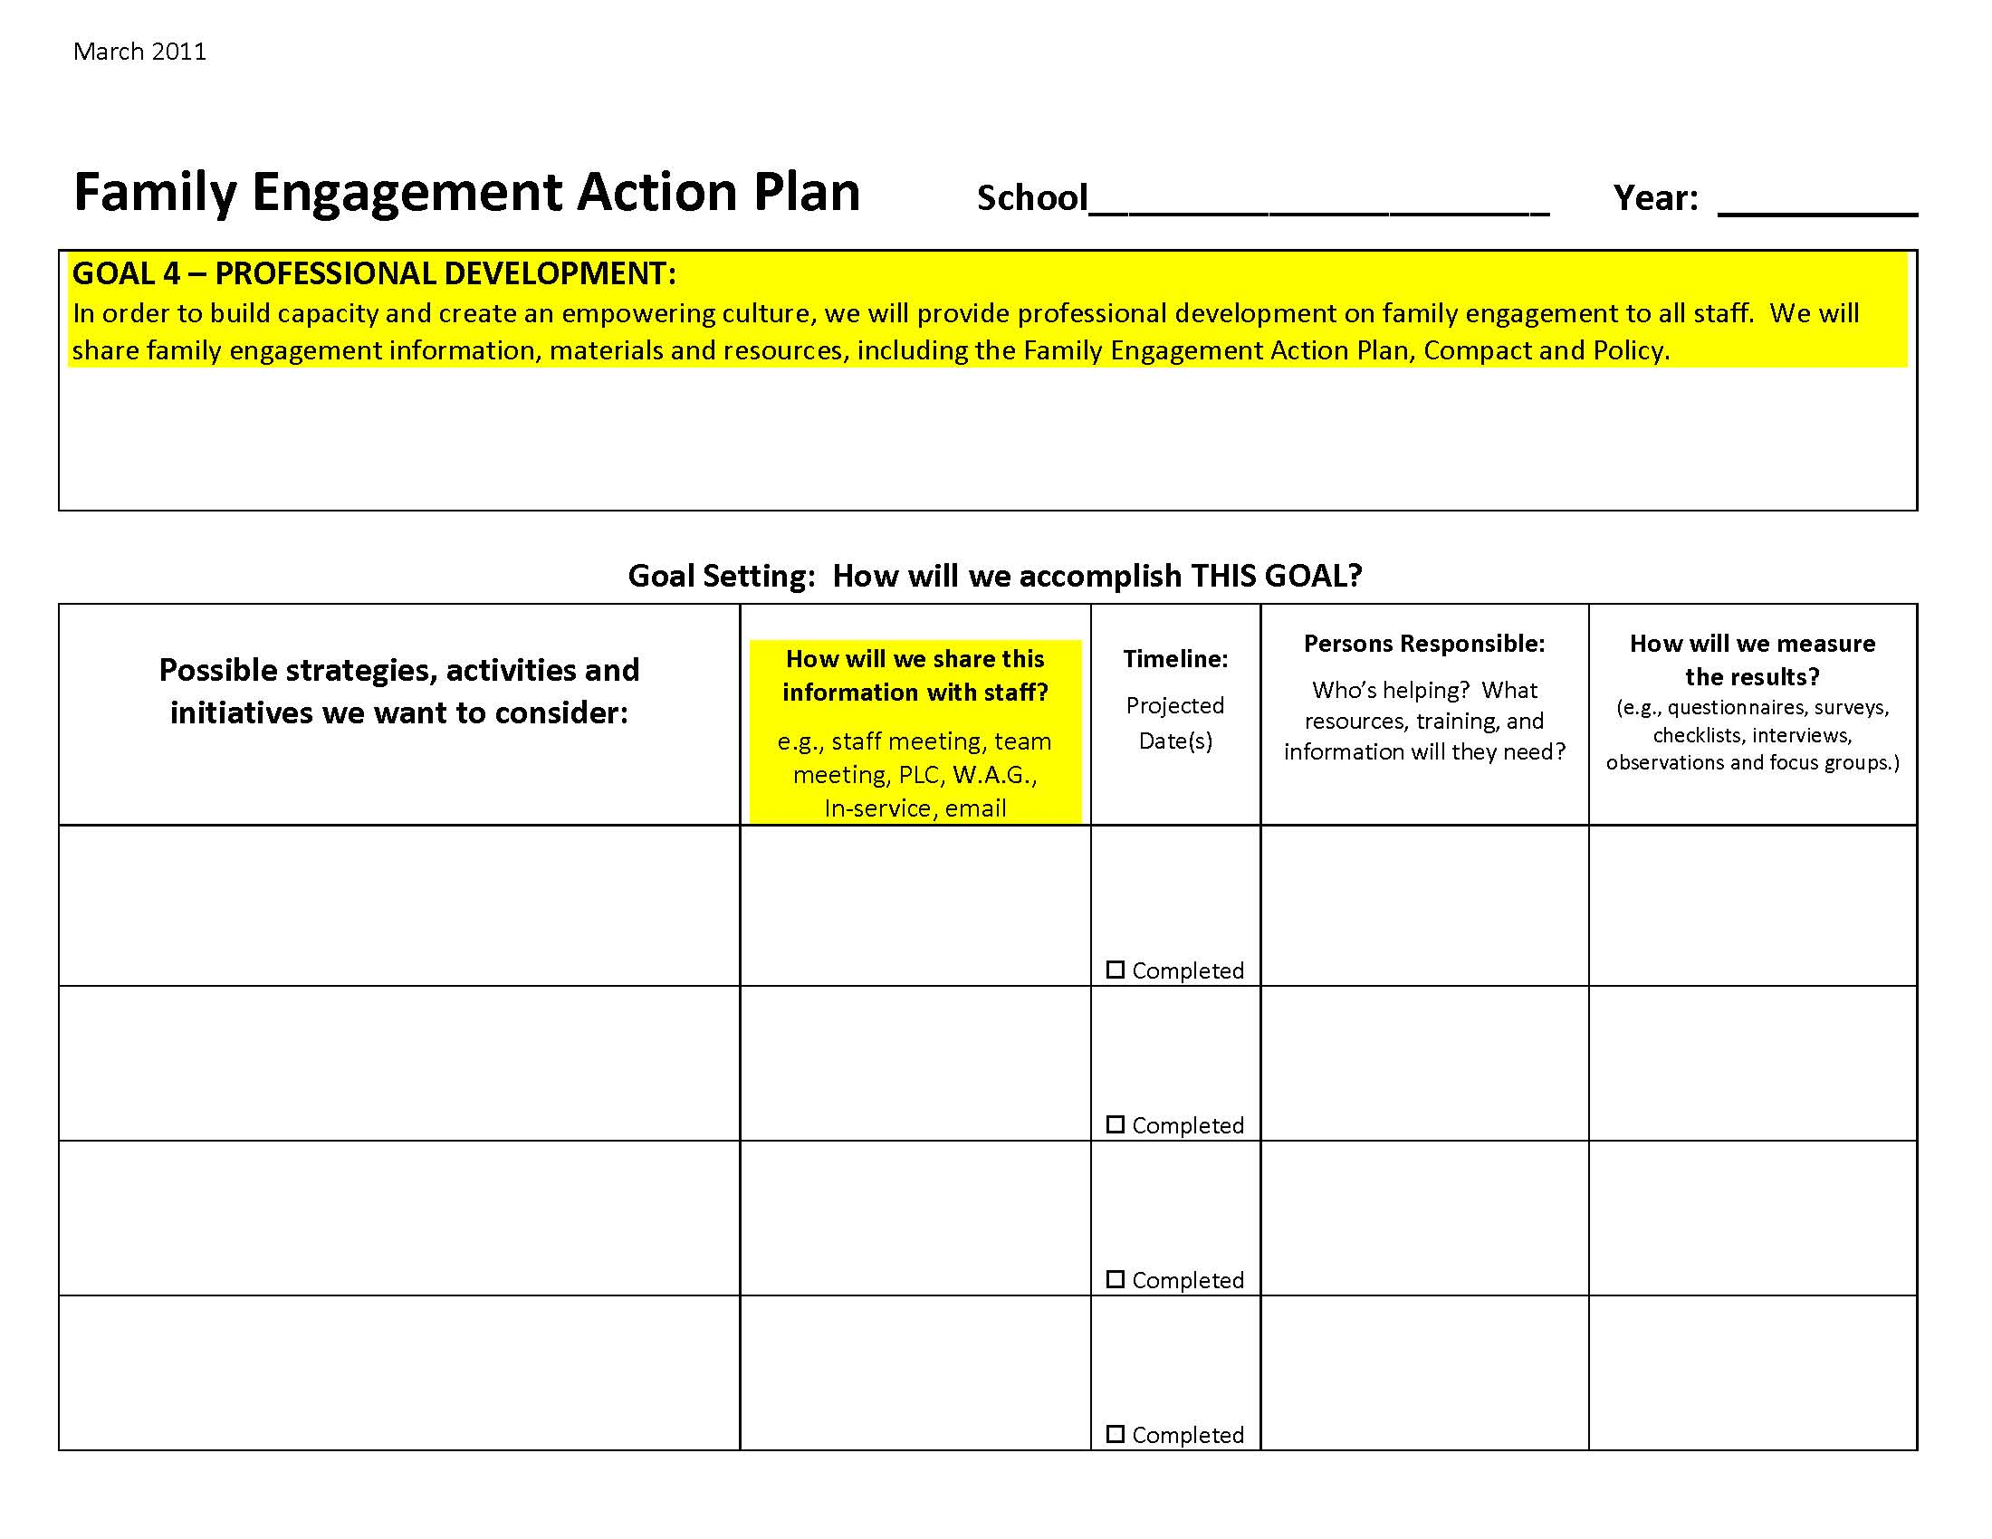

Slide 11
At your table:
As a group, review the Professional Development Goal.
On the light blue page, brainstorm the Strategies and Activities that could support the Professional Development Goal.
Focus on just August-October 2011
Family Engagement Facilitators will collect 1 completed form from your table.
We want your feedback and ideas!
Please offer any suggestions to improve the form.

Slide 12
Cohort Breakout Rooms:
Cohort 1 (SE)- Room 216
Cohort 2 (NE/West)– Room 225
Cohort 3 (South/NW)– Room 200 North
Cohort 4 (East)– Room 231
Cohort 5 (North)– Room 200 South
Cohort 6 (Heights)– Room 3 (downstairs)

