Slide 1
Welcome
to
Family
Math Night
Notes:
Welcome parents and talk about the importance of their involvement in their child’s learning. Then explain that you are going to give a brief overview of the Pre-K math program and allow them to participate in some of the same activities that their children do at school.

Slide 2
Pre-K Math Resources
Math
experiences
that
fill the holes
in learning
+
=
Notes:
Treasures is the adopted Pre-K curriculum with a focus on Literacy….It does address some math, however Kathy Richardson’s book
is based on the most current research about the development of young children,
is closely aligned with NCTM standards, and
provides the key mathematical areas children “Need to Know”:

Slide 3
Foundational Skills:
Number Sense
Algebra
Geometry
Measurement
Data
Notes:
Briefly explain each:
Number Sense: flexibility of number….knowing that five fingers held up means the same thing as the four letter word ‘five’….counting and being able to keep track of what’s been counted..
Algebra: at this level involves sorting and patterning
Geometry: spatial relationships---how shapes fit together, positional words
Measurement: the focus is on making comparisons between objects (length, volume, weight, time)
Data: sorting and counting as a means of finding answers to everyday questions

Slide 4
What you might see…
Daily Routines (10 minutes)
What Day is it Today?
How Many Days in School?
Weather Graph
Notes:
Daily Routines…
provide practice of math skills
make real world connections to math
foster ownership
change over time
Daily Routines provide a real world connection as to why we do math.

Slide 5
What you might see during a math lesson…
Opening (2-3min.)
Example: Sparkle
Core (15 min.)
Example: Roll Again
Closing (2-3 min.) Questions/Reflection
Notes:
Explain each activity quickly, because you will then walk parents through this lesson and allow them to play the activities.
Sparkle—refer to Teacher Summary Page Gets kids into the mathematical thinking mode
Roll Again—The core lesson. Mention that it is learned whole group before going into a small group activity.
Closing/Reflection is an important part of learning. Ask your child: What did you notice about the math game? Did you have to count the dots, or did you ‘just know’ how many there were? Did our organizers ever look the same?
Now do each activity with your parent group.
Then, give parents time to go through the packet and play the card game provided.

Slide 6
Family Math Night Kindergarten
Notes:
Welcome the families to our Family Math Night. This session will give them an overview of the program and the grade level specific sessions will provide them with games and activities they can use at home.

Slide 7
Name Collection Boxes
What are different names for:
5
Notes:
Pose the question on the slide. Allow “think” time. Then collect answers on a chart tablet (blackboard) at the front of the room.
Numbers can be named using one or more operations, words in any language, pictures, diagrams, measurements, etc.
Children use Name Collection Boxes to develop the idea that there are many equivalent (equal) names for one number. They are one of the many routines that children regularly work on in Everyday Math (pg 23 in the Home Connection Handbook)

Slide 8
Notes:
This slides provides the background for the program.
See presenter’s notes on pages 15 and 16 in the Home Connection Handbook

Slide 9
Notes:
Read statements from the slides and add in any details that are necessary for your families.
See the presenter’s notes on pages 15 and 16 in the Home Connection Handbook.

Slide 10
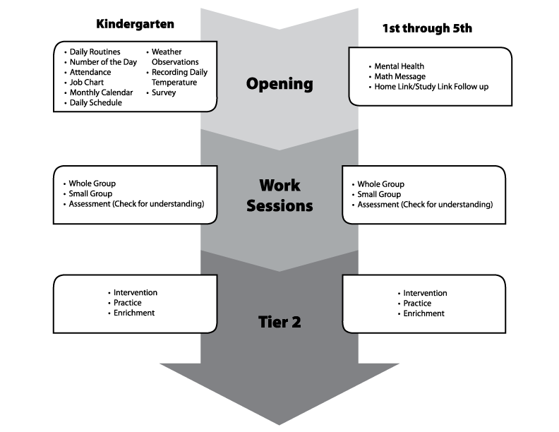
Mental Math
A typical
Everyday
Mathematics
Lesson
Notes:
This is the flow of a typical Everyday Mathematics.
Briefly explain each section.

Slide 11
Supporting Your Child in Mathematics
Notes:
Have the families turn to the pages titled “How to Help Your Child with Mathematics”. (pg. 30 and 31 of the Home Connection Handbook)
Briefly summarize the points on these two pages.
Songs, Games, and Chants are also included in your packet.

Slide 12
Family Math Night Kindergarten
Notes:
The families can now continue with the grade level specific lessons and activities.

Slide 13
Family Math Night 1st – 5th grades
Notes:
Welcome the families to our Family Math Night. This session will give them an overview of the program and the grade level specific sessions will provide them with games and activities they can use at home.

Slide 14
Name Collection Boxes
What are different names for:
12
Notes:
You will need to change the number to fit your grade level. Kindergarten may need to start with the number 5 and 5th grade may want to use a large number. 4th grade, 1st quarter will need to skip this Warm-up since it is the targeted lesson for the families.
Pose the question on the slide. Allow “think” time. Then collect answers on a chart tablet (blackboard) at the front of the room.
Numbers can be named using one or more operations, words in any language, pictures, diagrams, measurements, etc.
Children use Name Collection Boxes to develop the idea that there are many equivalent (equal) names for one number. They are one of the many routines that children regularly work on in Everyday Math (pg 23 in the Home Connection Handbook)

Slide 15
Notes:
This slides provides the background for the program.
See presenter’s notes on pages 16 and 17 in the Home Connection Handbook

Slide 16
Notes:
Read statements from the slides and add in any details that are necessary for your families.
See the presenter’s notes on pages 16 and 17 in the Home Connection Handbook.

Slide 17
Mental Math
A typical
Everyday
Mathematics
Lesson
Notes:
This is the flow of a typical Everyday Mathematics.
Briefly explain each section.

Slide 18
How to Help Your Child with Mathematics
Notes:
Have the families turn to the pages titled “How to Help Your Child with Mathematics”. (pg. 46 and 47 of the Home Connection Handbook)
Briefly summarize the points on these two pages. The top of page 47 discusses playing math games – this is when you can refer them to the back of their first page. This page shares commercial games that can be used to reinforce math skills (pg. 58 in the Home Connection Handbook).

Slide 19
Family Math Night 1st – 5th grades
Notes:
The families can now continue with the grade level specific lessons and activities.

