Slide 1
Conversations Not Presentations
Parent
Teacher
Conferences
Notes:
Presentation Notes:

Slide 2
When asked to evaluate
Parent Teacher Conferences
discussion revolves around these areas:
Room set-up
Days and dates
Interpreters
Length of conferences
Notes:
As a school, we spend a lot of time worrying about the logistics—how we’re going to set up the room, what days will we have conferences, if we’ll need interpreters, etc. All of these things are very important, however—we sometimes fail to dedicate an equal amount of time to talking about training and planning for the actual conference itself.
Presentation Notes:

Slide 3
The actual conference itself
Is rarely discussed.
WHY?
Notes:
Why is that? Why do you think we don’t spend time talking about the actual conference?
(ASK GROUP TO SHARE OUT IDEAS, SCRIBE IF APPLICABLE)
Presentation Notes:

Slide 4
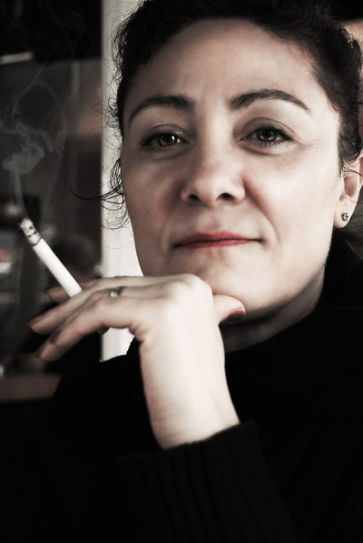
Two perfectly nice
people
who
care
about
Bobby
Parent
Teacher
Notes:
We know that conferences are one of the best times for these two people, a teacher and a parent, two people that truly care about a child to get together and talk exclusively about him and how he is doing in school academically, behaviorally, and socially.
Presentation Notes:

Slide 5
Bobby’s Parent
Teacher Conference
An opportunity
for communication and collaboration between these perfectly nice people.
Parent
Teacher
Notes:
That’s what a conference should be: Its an opportunity for communication and collaboration between these perfectly nice people.

Slide 6
Bobby’s Parent
Teacher Conference
What is she going to say about Bobby?
Parent
Teacher
Notes:
What are these two people thinking? “Ugh”. Both of them are uncertain. What is this conference going to be like? What am I going to hear about Bobby? What am I going to say about Bobby? What we know conferences should be and what they end up actually being are on both ends of the spectrum. The result isn’t nearly as effective (or enjoyable!) as it could be.

Slide 7
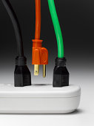
“We’re sorry…
The person you are trying to reach has been disconnected.”
Notes:
It all starts with one or both parties being disconnected. Why do you think parents might be disconnected?
(ALLOW FOR DISCUSSION – SOME POSSIBLE ANSWERS COULD BE PREVIOUS BAD EXPERIENCES, NOT FEELING LIKE THEY OR THEIR OPINIONS ARE VALUED, ETC. IF APPLICABLE, SCRIBE ANSWERS).
What about staff? As staff are we ever disconnected? Why?
(ALLOW FOR DISCUSSION – SOME POSSIBLE ANSWERS COULD BE PREVIOUS BAD EXPERIENCES, NOT FEELING LIKE THEY OR THEIR OPINIONS ARE VALUED, ETC. IF APPLICABLE, SCRIBE ANSWERS).

Slide 8
Let’s break it down, shall we?
Parent
Teacher
Notes:
So-lets break this down—lets take a look at what research says about what’s going on in our minds during conferences.
I want you to imagine you’re driving home on your last night of conferences. On the sticky notes at your table, write down 2 adjectives that describe how you feel.
(ALLOW PARTICIPANTS TIME TO WRITE DOWN THEIR ADJECTIVES ON THEIR STICKY NOTES. ASK THE GROUP TO THEN BRING THEIR STICKY NOTES UP AND ATTACH THEM TO A PIECE OF CHART PAPER. AFTER ALL THE STICKY NOTES HAVE BEEN PLACED, READ THE ADJECTIVES OFF TO THE PARTICIPANTS. AS YOU READ THE ADJECTIVES , ASK THE GROUP WHAT COMMON THEMES YOU HEAR.)

Slide 9
You’re ten minutes late.
What am I going to hear?
Bobby was a mess today.
Let’s get this over with.
Parent
Teacher
I had to take off work.
What am I going to hear?
Bobby’s a mess today.
Let’s get this over with.
Notes:
Remember, these are 2 perfectly lovely people—but we’re all human, and as a teacher you might be thinking all these things…and mom might be walking through the door with similar feelings. You’re exhausted after an evening of conferences, and mom is tired after working all day, chasing kids, etc.

Slide 10
What’s on your mind?
Behavior
Progress Report
Goal Setting
Interventions
Suggestions for parents
Teacher
Notes:
As a teacher, you wear many hats and have things on your mind. Depending on the time of the year you might have any one or all of these examples and MORE running through your mind.
Presentation Notes:

Slide 11
What’s on hers?
First and foremost, I want to know that you care about my child. I already trust that you are teaching him.
How is my child doing in school?
How does my child compare to others?
Now tell me…
You have a HEART for Bobby.
You have HOPE for Bobby.
You have HELP for Bobby.
Parent
Notes:
And mom…what she is thinking is that she just wants to know that you care about her child. National research and survey’s within our own district have shown that families just want to know that you care about their child. She trusts that you’re already teaching him, but she wants to know that you have a heart for her child, that you have hope for him and that you have help for him. And she wants you to listen to her.
Presentation Notes:

Slide 12
GET RECONNECTED
Get re-connected…
Let’s start at the beginning
Notes:
So, if we know these things, what do we do?
We start at the beginning.
Presentation Notes:

Slide 13
DO
Stand up, go to the door and greet the parent with a hand shake or just a touch on the arm.
“I’m so glad you came!
Come on, let’s go sit and talk . I’ve been looking forward to meeting you and talking about our Bobby. Such a great kid!”
Notes:
First things first, DO stand up, go to the door and greet the parent with a hand shake or just a touch on the arm. Start off positive by saying something like “I’m so glad you came, come on, lets go sit and talk, I’ve been looking forward to meeting you and talking about our Bobby! He’s such a great kid!”
Presentation Notes:

Slide 14
DO
Sit next to each other, not across the table. Start the conference with genuine friendly conversation.
“Wow, long day, huh?
Thanks so much for coming!“
Notes:
DO sit next to each other, not across the table. Start off with a genuine friendly conversation. Connect with the family first. “WOW—its been a long day thank you so much for coming!”
Presentation Notes:

Slide 15
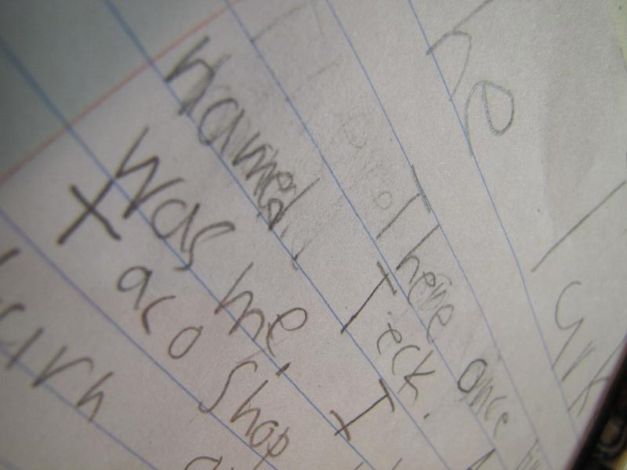
DO
Share, but don’t overwhelm.
“Let’s look at some samples of Bobby’s work, so you can get an idea of what he’s working on.
I’ll point out his strengths and some areas we need to work on along the way, okay?”
Notes:
DO share information with families, but don’t overwhelm them. We at times try to add every detail but this can add to the disconnect families have with us during conference time—choose your priorities and make sure the parent understands. Perhaps your priority is behavior within the class, discuss strategies the families use that could help you. If you have more information than can be shared in the conference time, don’t be afraid to schedule additional time later. Say something like “I don’t want us to feel rushed with this conference, Bobby has many areas he is excelling in and some that if we work together could turn into his strengths also, can we work out another time next week to visit?”
Presentation Notes:

Slide 16
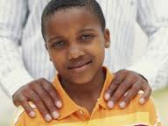
DO
Listen. Show appreciation
for the parent’s expertise.
“You know Bobby better than anyone. What can I do to support him? How do you feel about his progress this year?
Notes:
DO listen. Listen, listen, listen. Show your appreciation for the parent’s expertise, they come to you with knowledge and skills that will assist you in teaching the student. Don’t ask yes or no questions, and make sure you give parents time to process their answers. Sometimes it might take a minute or two for them to process before answering you. Try saying things like “You know Bobby better than anyone. What can I do to support him? How do you feel about his progress this year?”
Presentation Notes:

Slide 17
DO
Slow down.
Take your time.
Remember… this is a CONVERSATION,
not a presentation.
“I appreciate having this
chance to talk. And if we need more time, we can arrange another meeting, or a phone
call.”
Notes:
DO slow down! Take your time! Remember, conferences should be a time to have a conversation, not for you to give a presentation. A more relaxed pace creates an atmosphere of friendly conversation. Try using phrases like “I appreciate having this chance to talk, and if we need more time, we can arrange another meeting or a phone call.”
Presentation Notes:

Slide 18
DO
Become skilled at conducting a conference with an interpreter.
Look at the parents, not at the interpreter.
Pause for interpreting after just two or three statements.
Be patient. Allow extra time for interpreted conferences.
Provide parents with information on Multilingual Education Services
Notes:
Do take the steps necessary to know how to conduct a conference with an interpreter. You should look at the parents, not at the interpreter and make sure to stop for translation after two or three sentences. Remember, when using an interpreter you’re going to need more time to say the same thing you would without an interpreter, so don’t be afraid to allow for extra time. Finally, make sure you provide families with information on Multilingual Educational Services they can be a valuable resource for your families.
Presentation Notes:

Slide 19
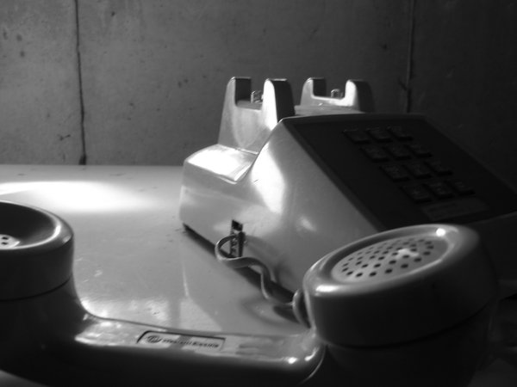
DO
Be proactive if a parent does not show up for the scheduled conference. Use that time to immediately call the parent and reschedule.
Let parents know that you missed them and still need to meet.
Tell parents that they do not need to wait for formal conferences to communicate.
“I missed you!”
Notes:
In many cases, when parents do not show up for a conference, we instead use that time to prepare for the next conference or attend to one of the dozens of tasks on our never-ending to-do lists. But let’s think about this… if you had arranged to have lunch with a FRIEND and they did not show up, what would you do? You would call them and make plans to try again! If we fail to reconnect with families who are no-shows, we send the message that we either did not notice or do not care. Nothing could be farther from the truth! It is important that parents understand that meeting together is not optional… it is absolutely imperative!

Slide 20
Effective Parent Teacher Conferences:
Share specific academic goals and progress
Honor the parent ‘s role
Establish a plan for ongoing communication
Strengthen the bonds between home and school
Empower parents to help their child succeed
Parent
Teacher
Notes:
Effective Parent Teacher conferences can do many things, think of the benefits from just one of these:
Share specific academic goals and progress
Honor the parent ‘s role
Establish a plan for ongoing communication
Strengthen the bonds between home and school
Empower parents to help their child succeed
To help you with connect with your families at conferences, we’ve compiled some different resources and tools that we’d like to share with you. Some of you may already have similar items; some of our newer teachers may not. These are resources that if used will help conduct effective parent teacher conferences. (PROVIDE STAFF WITH RESOURCES AND TOOLS FROM THE PARENT TEACHER CONFERENCE RESOURCE CD INCLUDED IN THE TRAINING MANUEL)
Presentation Notes:

