Slide 1
for schools
customer service

Slide 2
“Don’t try to tell the customer
what he wants.
If you want to be smart,
be smart in the shower.
Then get out, go to work,
and serve the customer.”
Gene Buckley
Notes:
These quote slides can be displayed as guests are being seated.

Slide 3
“It’s well worth remembering
that the customer is the most
important factor in any business.
If you don’t think so…
try getting along without them
for a while.”
Napoleon Hill
Notes:
These quote slides can be displayed as guests are being seated.
These quote slides can be displayed as guests are being seated.

Slide 4
“Coming together is a beginning.
Keeping together is a process.
Working together is success.”
Henry Ford
Notes:
These quote slides can be displayed as guests are being seated.

Slide 5
“People expect good service
But few are willing to give it.”
Robert Gately
Notes:
These quote slides can be displayed as guests are being seated.

Slide 6
customer service
Notes:
Title slide

Slide 7
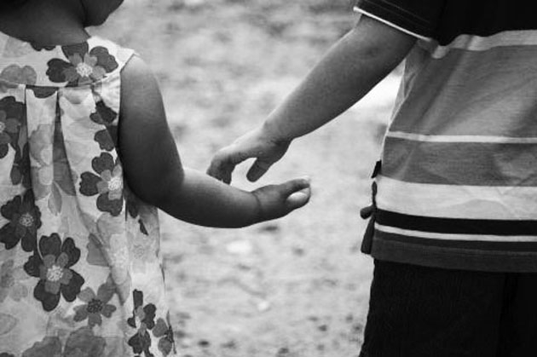
be nice
Notes:
We know what good customer service is. We’ve all had the experience of being a customer.

Slide 8
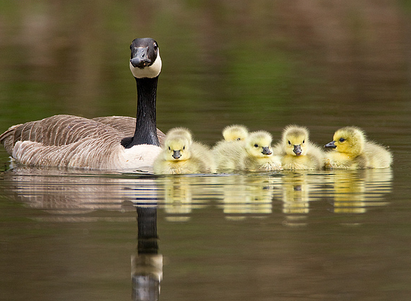
Why do schools need good customer service?
When everyone in the school community feels like a member
of the family, they become loyal and take part in the education of our children in ways they have never envisioned.
it’s easier when we all work together.
Notes:
Why do schools need to have good customer service? Research tells us that when families and the community are engaged and partnering with schools, student achievement increases. We need families and community members to become loyal, and in order for them to feel as though they are needed and wanted, we must consider customer service.

Slide 9
taxpayers
neighbors
parents
who are our customers?
community
your mom
students
school staff
Notes:
Who are our customers? (Wait for animation to complete)
Our customers are anyone who has an interest in our school or district. That includes a lot of people, including our coworkers.

Slide 10
office staff
librarians
teachers
administrators
custodians
students
security
whose job is customer service?
painters
counselors
lunch aides
paras
social workers
superintendent
coaches
Notes:
Whose job is customer service? (Wait for animation to complete)
It’s all of our jobs.

Slide 11
Where do you fit in?
it’s your job!
EVERY SINGLE EMPLOYEE of the school has the same power to
make or break
the perceptions of our customers.
Notes:
No matter what position you hold in your school or district, you have the responsibility to provide excellent customer service to anyone you work with or come in contact with. Each of us holds the power to make or break the perceptions that our customers have about our school and our district.

Slide 12
It’s not just about having a quality product.
It’s about how we deliver the product.
68%
of customers will leave a place of business based on the indifferent attitude of a single employee.
How does this relate to our customers?
have we earned a tip?
Notes:
And it’s not just about providing a quality education. It doesn’t stop there. Research shows that 68% of customers will leave a place of business based on the indifferent attitude of a single employee. How does this relate to our customers? (Solicit responses from the group).

Slide 13
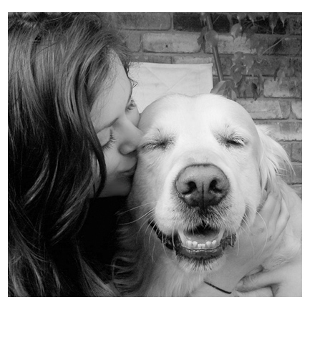
We aren’t loyal
just for the sake of being loyal.
We are loyal because the other person has proven they have our best interest at
heart
what does loyal look like?
Notes:
So what does loyalty look like? We have to make sure that our customers know that we have their best interests at heart. That means listening to them. Ask parents, “Is there anything I can do for you?” “Is there anything special I can do for your child?” Both of these are small questions that can have huge positive results. If we give as much as we can to our customers, they will give much to us. That is loyalty.

Slide 14
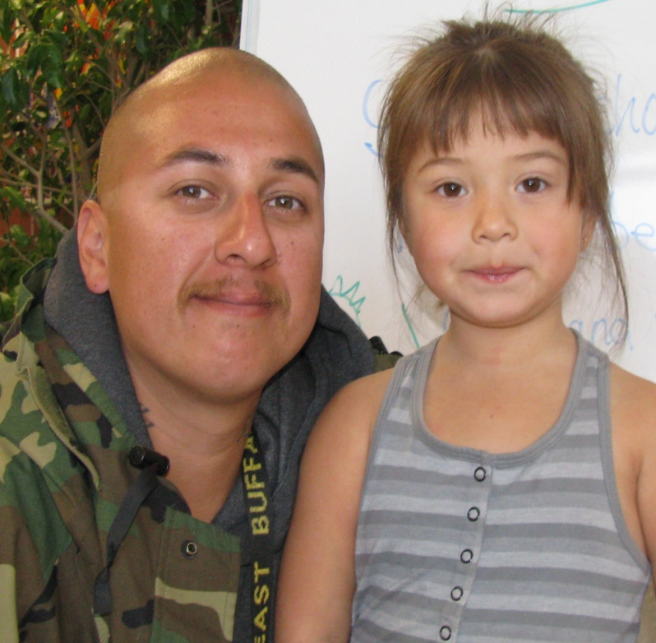
Parents tell us…
feeling welcome and being treated with respect by school staff is the number one reason
they feel a
with a school.
connected
get the picture?
Notes:
This is what we hear from parents. (Allow time for participants to read the slide). Wow! Customer service is highly important if we are going to build partnerships. The service we provide is just important, and sometimes more important, than the product we provide. We want our families and community partners to become or remain loyal to us. And it is our responsibility to reach out and make that connection.

Slide 15
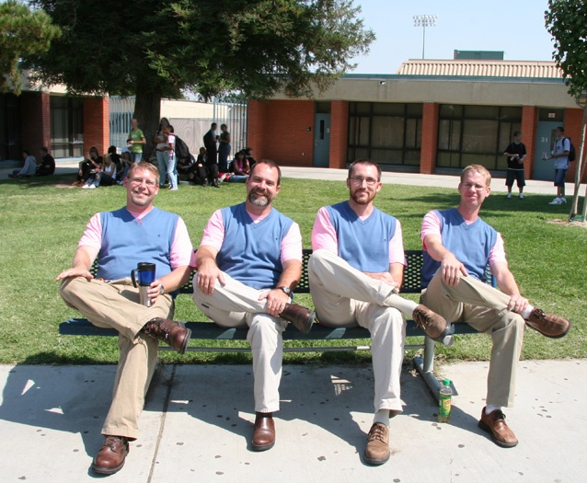
How we treat each other
leads to how we treat our customers.
it starts with us
Are we ready to have company over? Not until we first enjoy each other’s company.
It starts with simple things like a smile in the hallway or holding a door open for your coworker.
Notes:
And how we treat each other leads to how we treat our customers. How do we respond when a colleague asks for information that she needs to complete her task that day? How do we greet our students each day? How do we greet staff from the school service center. All of these things are part of what make up our school culture. And our external customer service flows out of our internal customer service. Do we have a friendly, welcoming school culture, or is our culture seen as intimidating and unwelcoming?

Slide 16
it all boils down to this…
Schools belong to the people.
We are simply the caretakers.
In the end, families and taxpayers depend on us to give them the best product for their money, so we have to prove to them that we are willing and flexible partners in this endeavor.
Notes:
It basically boils down to this: Schools belong to the people. We are simply the caretakers. We have a responsibility to provide a quality service in a way that welcomes and seeks to involve all people who have an interest. We cannot afford to miss opportunities to make connections with families and welcome partnerships.

Slide 17
be nice

