Slide 1
TESTING
TESTING
How We Measure Academic Achievement

Slide 2
Students are assessed in a variety of ways.
DIAL
State Assessments
ACT
SAT
Notes:
To determine their progress, students are assessed in a variety of ways from Kindergarten through graduation. While the number of testing methods used varies, there is not one particular test or assessment that determines your student’s academic progress. It is a culmination of several assessment methods.

Slide 3
FORMATIVE ASSESSMENTS
ON-GOING

Slide 4
FORMATIVE ASSESSMENTS
ON-GOING
WHAT?
Classroom observation
Chapter reviews
Homework assignments
Notes:
One type of assessment method is the formative assessment. A student’s progress is checked at regular intervals in order to help to improve the student's performance. The process is interactive and is used to drive instruction in the classroom.

Slide 5
FORMATIVE ASSESSMENTS
ON-GOING
WHY?
Teachers adjust classroom instruction based on this immediate feedback.
Notes:
Teachers are able to use this information to make decisions about instruction. If the students did not learn a specific skill, the teacher can look for alternative startegies.
Did everyone understand the material?
Did I a variety of activities that address all learning styles?
Can I use this successful teaching strategy for the next lesson?

Slide 6
FORMATIVE ASSESSMENTS
ON-GOING
HOW ARE PARENTS INFORMED?
Report Cards/Progress Reports
Conferences
Phone Calls

Slide 7
SUMMATIVE ASSESSMENTS
STANDARDIZED
TESTS
a snapshot in time
Notes:
There will be times that students will take a summative assessment. This is the process of evaluating (and grading) the learning of all students at one point in time.

Slide 8
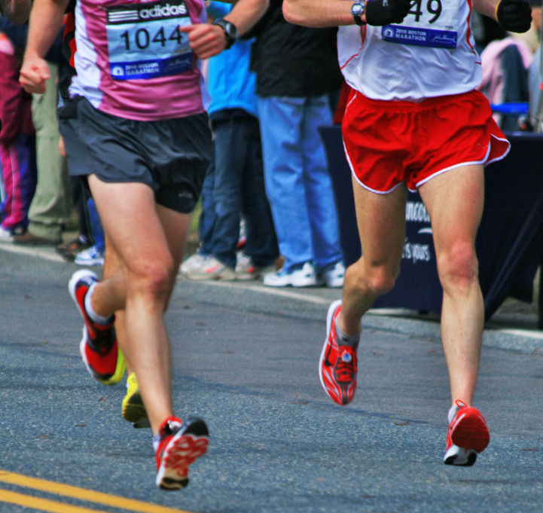
SUMMATIVE ASSESSMENTS
STANDARDIZED
TESTS
WHAT?
Use one standard to measure all students at the same time.
Determine if students are proficient (on grade level) in the tested area.
a snapshot in time
It’s just one race (test)
Notes:
Consider the following example: Runners jog daily, measuring their progress by distance ran and the time it took. The daily sessions are often done in preparation for a big race. The race is a measure of that runners performance on that day at that particular event. The runner could have done better previously or may start off well, but something along the way impacted their performance at that point in time.
The same can be said for Summative Assessments. A student’s performance on that particular date may not be a totally accurate reflection of their progress because so many things can impact the results. That is why the student is assessed using both summative and formative means.
The list shows a few of the standardized tests given in the district.
The ones your students take are:

Slide 9
SUMMATIVE ASSESSMENTS
STANDARDIZED
TESTS
WHY?
Summative assessments evaluate the effectiveness of programs, instructions, and curriculum for an entire school or program.
a snapshot in time
Where did I place?
It’s just one race (test)
Notes:
The results of these assessments are used as a measure of a students proficiency in a certain subject at the time of the test.
The school uses the results to ensure that the teaching methods are meeting the needs of the students; to determine if student needs additional support in a given area; and to identify professional development needs.

Slide 10
SUMMATIVE ASSESSMENTS
STANDARDIZED
TESTS
HOW ARE PARENTS INFORMED?
Report Cards
Progress Reports
Conferences
Phone Calls
a snapshot in time
Notes:
The results of these assessments are used as a measure of a students proficiency in a certain subject at the time of the test.
The school uses the results to ensure that the teaching methods are meeting the needs of the students; to determine if student needs additional support in a given area; and to identify professional development needs.

Slide 11
KANSAS STATE ASSESSMENTS
FEDERAL MANDATE
NO CHILD LEFT BEHIND ACT (NCLB)
All students will be proficient (on grade level) or better by 2014.
A school must make Adequate Yearly Progress (AYP) toward that goal.
Notes:
The most common Summative Assessment we talk about is the Kansas State Assessment. Since the results of this one test is most often quoted and published, we will spend some time discussion it tonight.
The KSA was developed as part of complying with the No Child Left Behind Act. The Act sets a goal that all students will be proficient in both Reading and Math by 2014.
Proficiency is measured by Adequately Yearly Progress better know as AYP. Each year, schools must have minimum amount of students be proficient or better (exceeds, exemplarary) in reading or math. The level gets higher each year. When you hear that a school made AYP, its saying they met or exceeded the current year’s minimum standard.

Slide 12
ADEQUATE YEARLY PROGRESS
There are multiple ways to look at the data…
Students must make adequate progress as a whole and in sub-groups
Notes:
The most common Summative Assessment we talk about is the Kansas State Assessment. Since the results of this one test is most often quoted and published, we will spend some time discussion it tonight.
The KSA was developed as part of complying with the No Child Left Behind Act. The Act sets a goal that all students will be proficient in both Reading and Math by 2014.
Proficiency is measured by Adequately Yearly Progress better know as AYP. Each year, schools must have minimum amount of students be proficient or better (exceeds, exemplarary) in reading or math. The level gets higher each year. When you hear that a school made AYP, its saying they met or exceeded the current year’s minimum standard.

Slide 13
SUB-GROUPS:
Students must make adequate progress as a whole and in sub-groups
Economically disadvantaged
Special education
Limited English Proficient students (also known as ELL---English Language Learners)
Students from major racial/ethnic groups.
Notes:
The AYP data can be shown in a variety of ways. The data can be reported in the following ways; as a whole, in subgroups, or by individual students.
When we know more about the data, we can put together strategies to help our students continue to succeed.
If we give you a clear picture of your child’s performance, we can work together to make sure they reach their full potential.

Slide 14
HOW DID OUR DISTRICT PERFORM IN MATH?
Grade | 2006 | 2007 | 2008 | 2009 | 1 year change | 3 year Trend | 2009 State Average
3rd | 68 | 74.3 | 77.5 | 79.2 | +1.7 | +11.2 | 88.3
4th | 68.8 | 73.8 | 76.6 | 75.6 | -1.0 | +6.8 | 87.0
5th | 67.4 | 76 | 80.6 | 78.3 | -1.3 | +10.9 | 87.2
6th |  | 59.7 | 62.4 | 61.3 | -1.1 | +1.6* | 83.4
7th |  | 62 | 62.8 | 57.1 | -5.7 | -4.9* | 80.6
8th |  | 55.9 | 59.2 | 59.8 | +0.6 | +3.9* | 78.3
11th |  | 56.9 | 57.9 | 56.2 | -1.7 | -0.7* | 79.3
Notes:
(Review the district data as projected on the screen)

Slide 15
HOW DID OUR SCHOOL PERFORM IN MATH?
INSERT SCHOOL MATH SCORES HERE
Notes:
(Review SCHOOL SCORES as projected on the screen)

Slide 16
WHAT ARE WE DOING TO IMPROVE?
List your schools specific MATH strategies and interventions here.
Strategy/intervention
Strategy/intervention
Strategy/intervention
Strategy/intervention

Slide 17
Grade | 2006 | 2007 | 2008 | 2009 | 1 year change | 3 year Trend | 2009 State Average
3rd | 65.7 | 68.7 | 70.9 | 73.2 | +2.3 | +7.5 | 85.1
4th | 72.5 | 71.6 | 76.9 | 75.9 | -1.0 | +3.9 | 87.3
5th | 70 | 72.1 | 73.4 | 73.2 | -0.2 | +3.2 | 84.9
6th |  | 63.4 | 64.7 | 65.6 | +0.9 | +2.2* | 86.3
7th |  | 70.5 | 71.1 | 70.5 | -0.6 | 0* | 87.9
8th |  | 63.9 | 66.4 | 65.4 | -1.0 | +1.5* | 85.1
11th |  | 63.4 | 68.2 | 69.8 | +1.6 | +6.4* | 84.6
HOW DID OUR DISTRICT PERFORM IN READING?
Notes:
(Review the district data as projected on the screen)

Slide 18
INSERT SCHOOL READING SCORES HERE
HOW DID OUR SCHOOL PERFORM IN READING?
Notes:
(Review SCHOOL SCORES as projected on the screen)

Slide 19
WHAT ARE WE DOING TO IMPROVE?
List your schools specific READING strategies and interventions here.
Strategy/intervention
Strategy/intervention
Strategy/intervention
Strategy/intervention

Slide 20
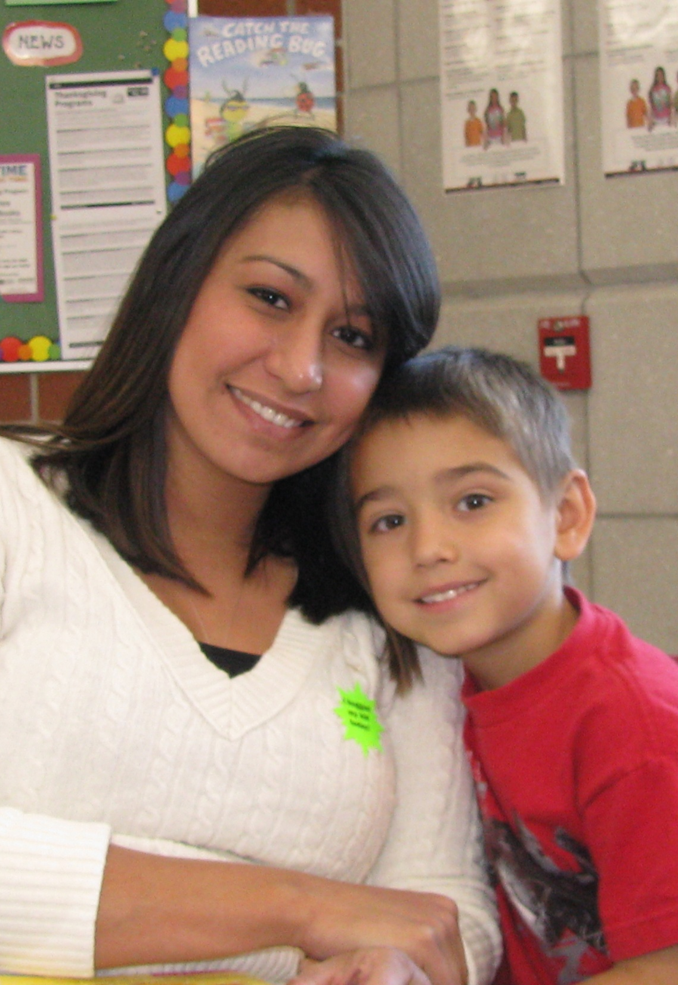
HOW CAN PARENTS HELP?
Talk with your children about your expectations
Monitor homework and let the teacher know if your child is having trouble
Attend Parent-Teacher Conferences
Attend family nights at school
Notes:
Tonight, I have shown you what we are doing at school to help your child achieve academically. But we cannot do it alone. We need everyone—the staff, the students, the parents, and our community—to be a part of the education process. We’ve listed a few ways that you can partner with the school to help your child succeed in school.
(go through the list—adding comments when needed. Such as, “Talk with your child about your expectations. You are who your child wants to please and do well for. Make sure you let them know your goals for them in regards to how they perform in class, how they behave in school, and how far you want them to go. If college is your wish for them, let them know.”)

